Slide 1
Doubling the number of children and young active disciples in the Church of England by 2030 is the first stated bold outcome of the Vision and Strategy.
Notes:
To set the context
The Church of England has doubling the number of children and young active disciples by 2030 as the first stated bold outcome of the Vision and Strategy

Slide 2
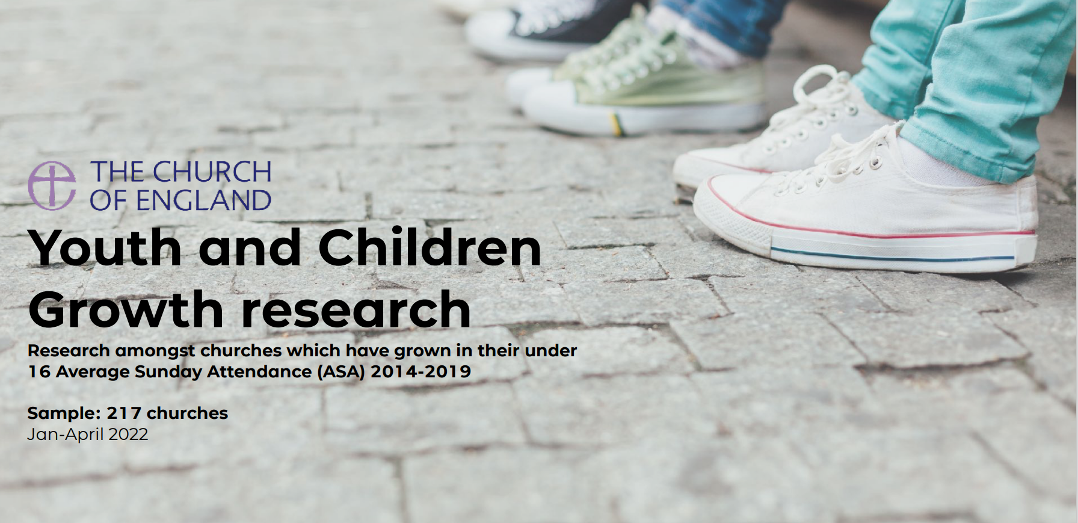
Youth and Childrens Growth research (churchofengland.org)
Notes:
In 2022 qualitative and quantitative research was conducted with churches who had grown numbers of children and young people consistently.
You can find it here.

Slide 3
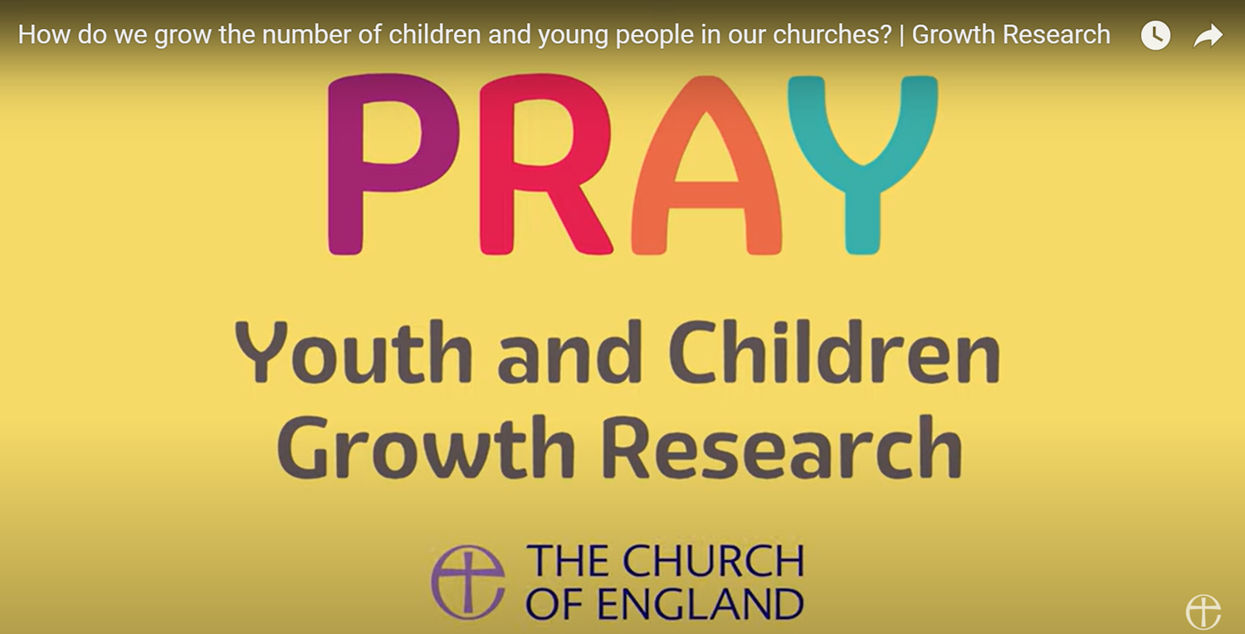
https://www.youtube.com/watch?v=u_1bvj7XXe0
Notes:
The principles have been summarised in a short and simple film. Not going to play it now but there’s a link for it here in case you haven’t seen it.
We have used the P.R.A.Y acronym as an easy and catchy way to remember the key principles which lead to growth in the numbers of children and young people in our church. P is for prioritise, R is for resource, A is for adapt and Y is for you, how everyone can be involved.

Slide 4
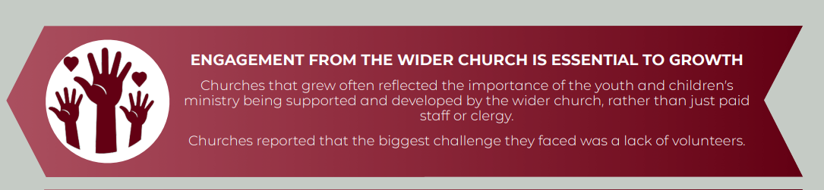
You
Notes:
The research I conducted was a follow up to this. I tested out these principles with growing churches and asked them who had been involved in the praying, prioritizing, resourcing and adapting to welcome children, young people and families.

Slide 5
Growth is happening in a variety of contexts
Prayer underpins all growth
Developing a healthy culture around volunteering resources growth
Growth comes when there is a focus on family and community rather than on one particular demographic group
Partnerships enable growth
Notes:
I conducted a series of 3 focus groups with representatives from 11 different churches all of whom were in the top 25 for growth in their under 16 Average Sunday Attendance (ASA) in 2023
These were some of my key findings from the focus groups.

Slide 6
Growth is happening in a variety of contexts
Church planting works in enabling rapid growth over a short period of time but is not the only route to growth
Notes:
8 out of the 11 participating churches were churches that had been planted or transplanted or revitalised over the past 5 years. In these cases a new leader, accompanied by a team (sometimes a very small team) and sometimes, but not always, with funding, deliberately moved from a larger church into a new context, usually into an existing building with a small established congregation. In these cases there had been a need to engage and involve the existing congregation in new ventures.
However, it is worth noting that three of the churches were seeing growth in the context of an established leader with an established team but who were prepared to adapt what they were doing so that children, young people and their families felt welcomed into the church.
The churches in the focus group were also diverse in terms of their original size, their location and their tradition. What I learnt from this is that anyone can grow but you do need to involve everyone in the process of change that leads to growth.

Slide 7
Prayer underpins all growth
Prioritising starts with prayer.
Notes:
This is worth continuing emphasis. The participants talked all about how prayer was a core part of what they were doing.
The churches in the group had all involved as many people as possible in praying for children, young people and families. Time was taken in services to specifically pray for CYF, home groups were asked to get involved in praying for this and prayer meetings were started or changed so that they intentionally focussed on missional prayer for children and young people, prayer walks were organised.
Intentional prayer, which looked very different in different places, but which was involving lots of people was underpinning all the growth that these churches were seeing.
The best way to start your growth journey is to involve as many people as possible in praying for it.

Slide 8

Developing a healthy culture around volunteering resources growth
Notes:
Many of these churches had worked hard to develop a culture of ‘team’ for their volunteers. With ‘team’ being a community you join, rather than gap in a rota that you fill. This included regularly sharing the vision with them, meeting to pray, offering training and one-to-one check-ins, giving opportunities to step down or change where you are serving and finding times to be together. This ensured that volunteers felt that they were part of something bigger.
It was also felt to be important to start by asking people what they were passionate about rather than telling them what jobs were needed. Matching ministries to peoples’ passions ensured that people held the vision and were highly motivated. Volunteering was seen as part of people’s discipleship and not simply filling a gap on a rota.
Although many of these churches employed staff to oversee their CYF work, not all did. Even in the churches that did employ staff there was a recognition that volunteers were absolutely essential and the model that simply employs more and more people to do the ministry is unsustainable.

Slide 9
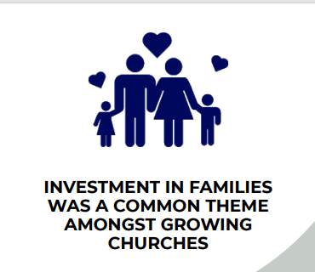
Growth comes when there is a focus on family and community rather than on one particular demographic group
Notes:
In the churches I spoke to there was a focus on whole families and a recognition that children grow into youth. Specific children’s ministry always needs to have an eye a few year’s ahead and also needs to look beyond the children to the parents and those closely involves with the children.
In all cases there was as much engagement with parents as there was with children. Even where the initial contact was through schools, efforts were made to draw in parents.
These churches talked about the importance of encouraging people to feel part of a community. Intergenerational relationships were highly valued and this was even in contexts where age-specific ministries were the norm. Where churches ran specific groups for children alongside the Sunday service, efforts were made to build these relationships at other times and in other ways.
Welcome was a key theme and this involved welcoming for everyone, whatever their age, and creating an environment where everyone feels comfortable. This included reordering buildings, making services more informal and celebrating children being children in church, in one case stopping the whole service to applaud and give thanks when a child made noise.
One church leader talked about how he tried to bring people in from the side-lines and give them a place at the centre. Everything he did was focussed by this value.
It was felt that consistency was key and that meeting monthly was probably not often enough to build community. These churches, as far as possible, were providing weekly groups and activities.
So, in all cases resources were targeted at whole families and on building community.

Slide 10
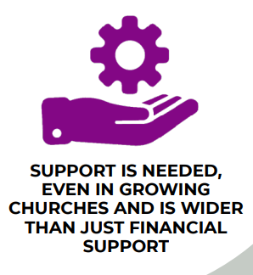
Partnerships enable growth
Notes:
In over half of the churches, partnerships with local schools, pre-schools and/or other youth organisations e.g. Scouts, was cited as a key component of growth.
Partnering with other local churches to pray for each other and share resources was seen as helpful, especially when the church was only one of several in a town or city. This helped with prioritisation, meaning that the churches were not all trying to do all the same things but could concentrate on doing a few things well, knowing that those they were not focussing on would be well served elsewhere.
Partnering with the local community and serving them through cafes, drop-ins and social action was also a key theme in many cases
Partnerships with parachurch and other organisations were also seen as helpful for funding, training and resourcing.
It was noted that competition does not help growth.
In all this, through volunteers, through engaging whole families and through all sorts of partnerships it seems that growth happens when you get lots of people involved and the more people you can get involves the more you are likely to grow. Everyone has as part to play!

