Slide 1
How to complete your Statistics for Mission form and why it matters
or
If you’re statty and you know it: clap your hands; if you’re not statty: don’t stamp your feet but come along to our webinar and we’ll try to help
Emma Buchan, Ken Eames

Slide 2
Plan for the session
How to fill in your Statistics for Mission form;
Some of the ways the information is used;
Questions.
Feel free to post questions in the chat as we go along.

Slide 3
Statistics for Mission: overview
The annual Statistics for Mission survey aims to summarise attendance and participation at each Church of England church.
The information is used extensively by national and diocesan colleagues, as well as locally.
Everyone who uses this information is extremely grateful to everyone who takes the time to fill in the surveys.
We receive information from 85-90% of churches.
Most of the information collected is a subset of information that churches already record, e.g. in registers of services, baptisms, marriages, and funerals.
Many of the things we collect have been asked about consistently for years, sometimes decades.
National and diocesan totals and trends are published each year.
Notes:
Asking for information is not a recent idea! I check all the figures.

Slide 4
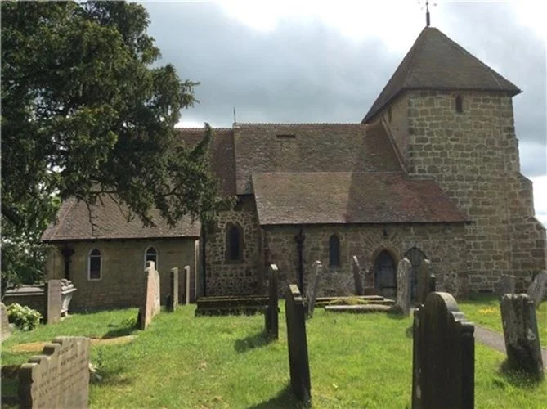
Q: So, what does the Stats for Mission survey ask about?
A: Quite a lot of things! Mostly things that every church either does, or wouldn’t be surprised to do:
Attendance at worship - in October & on a “Usual Sunday”;
Easter, Christmas & Advent attendance;
Electoral Roll;
Baptisms, marriages, & funerals;
The number of people who worship regularly with your church (your “Worshipping Community”);
Summary information about any fresh expressions of Church run by your church.

Slide 5

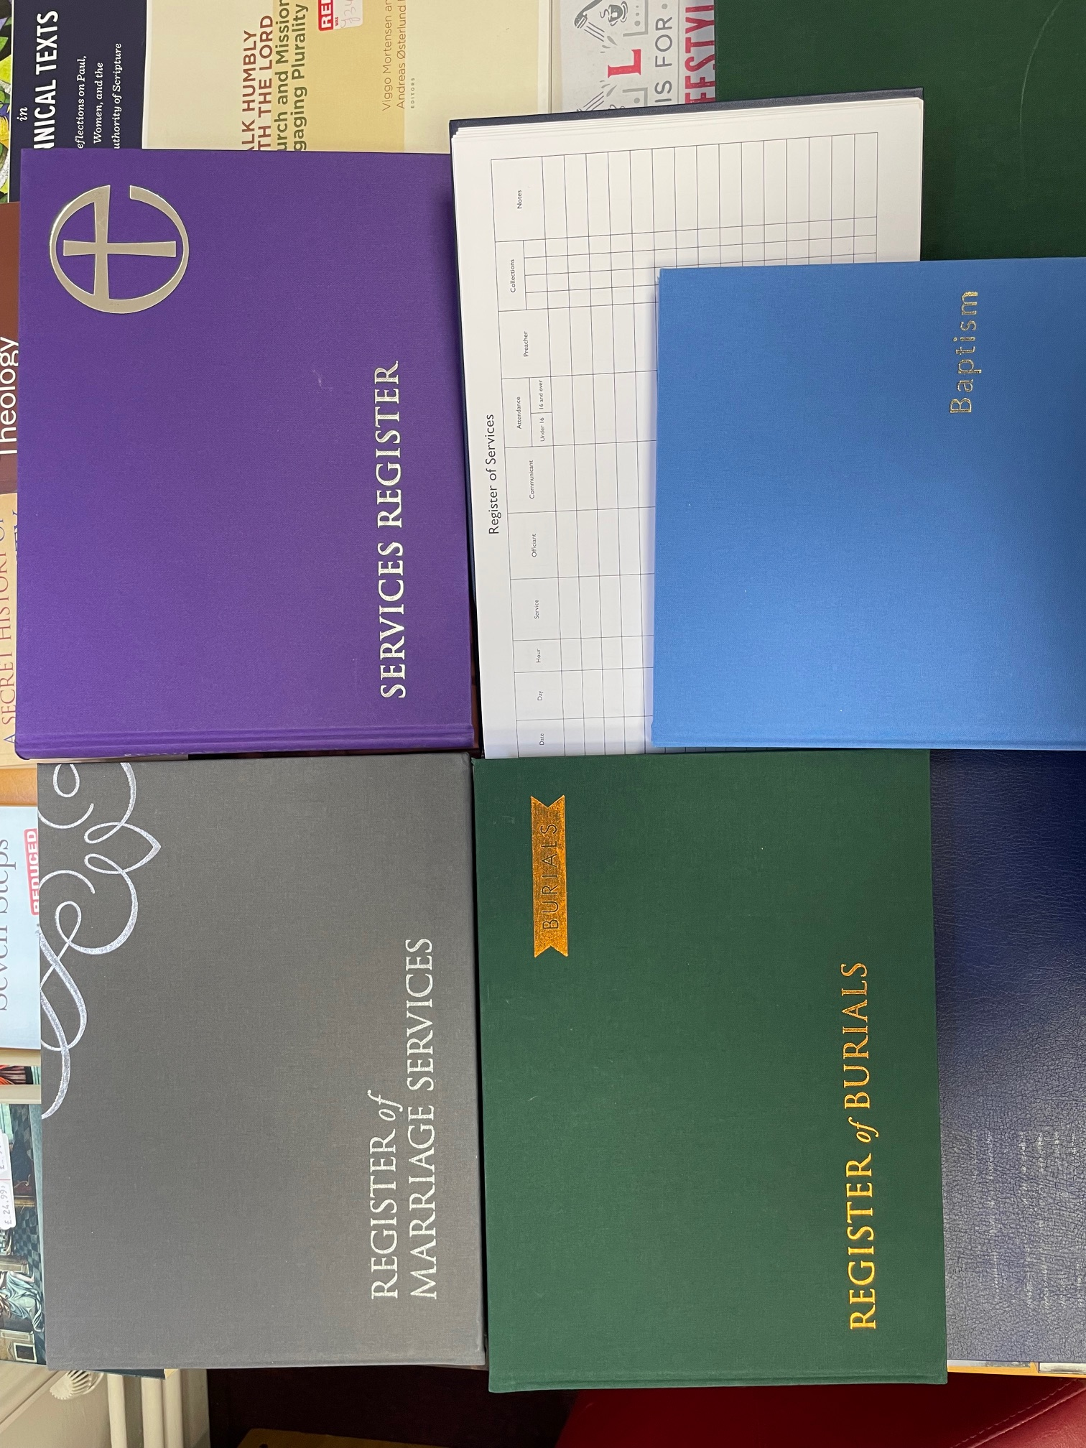
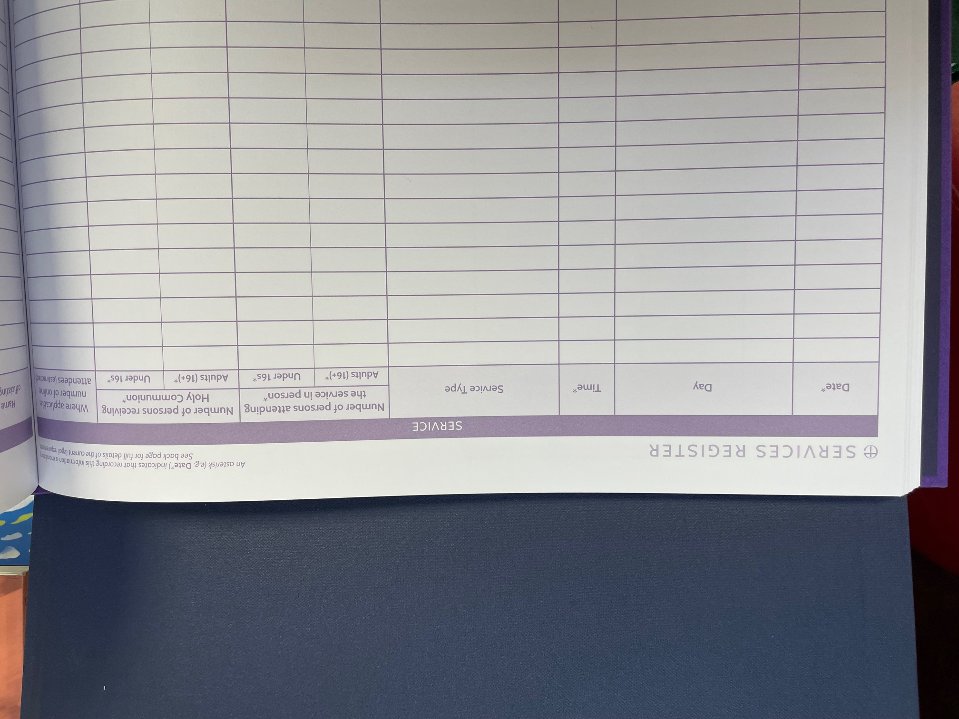
Q: Where do I find all that information?
A: Most of it is based on what’s in your Registers
Notes:
N.B. There’s an online version…

Slide 6
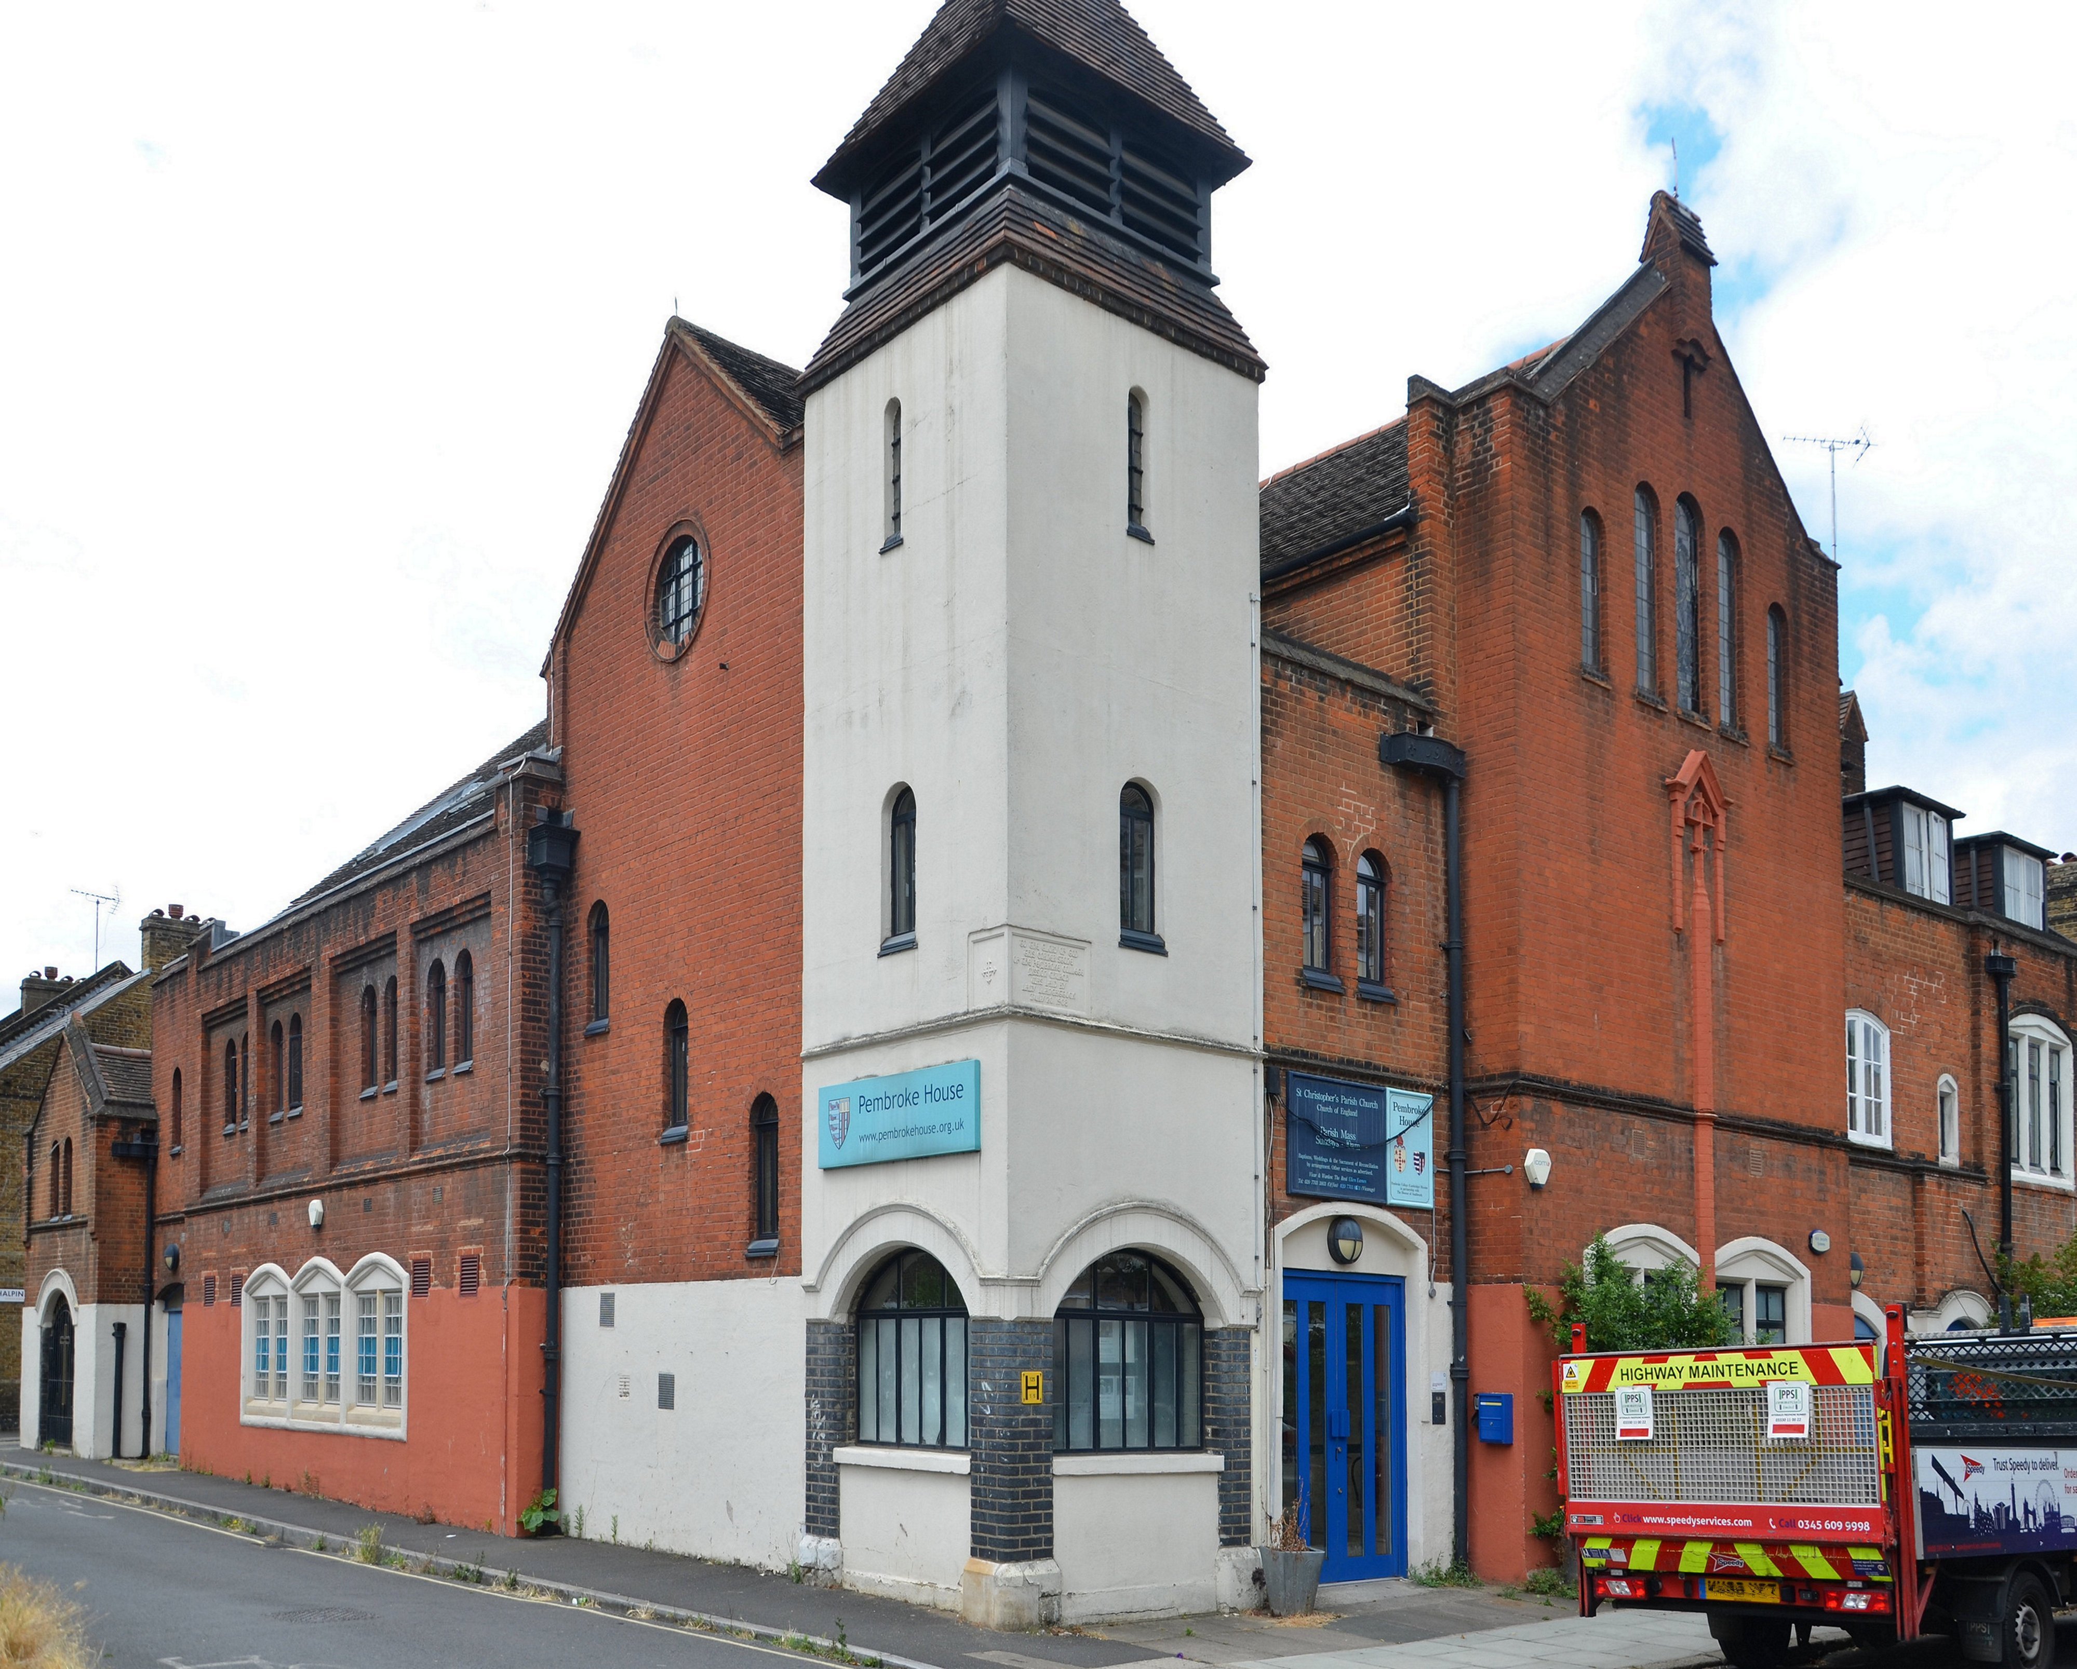

Q: We do other things too! Why doesn’t the survey ask about those?
A: It could. But then it would be even longer. Please use the comments box to tell me about other things that matter – if lots of churches say there should be a question about attendance on Remembrance Sunday, for instance, I might well add it (if I were sure someone was going to make good use of the information).

Slide 7

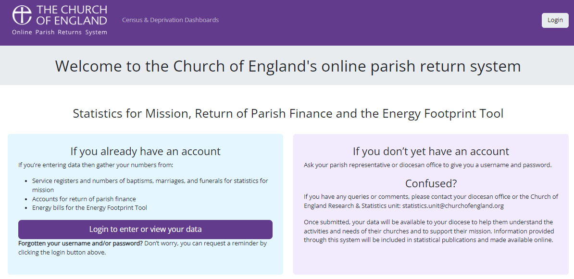
Q: Where can I find and fill in the survey?
A: On the online parish returns system: https://parishreturns.churchofengland.org/
Notes:
It does some error-checking as you go along.

Slide 8
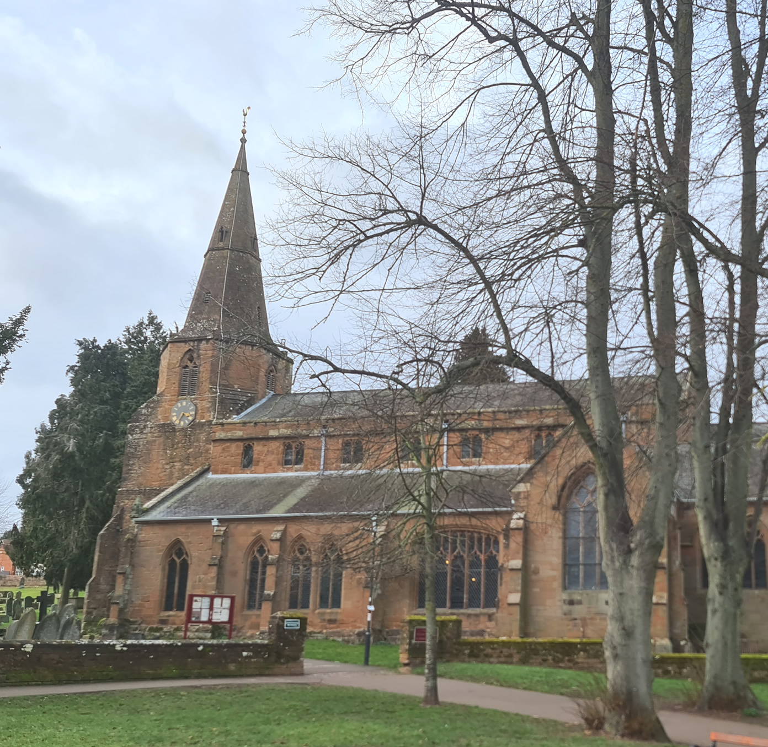
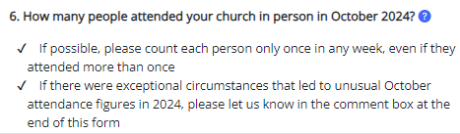
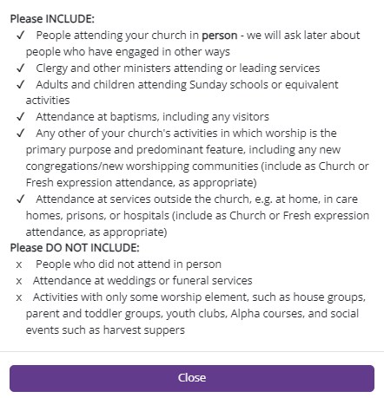
Q: Are there any explanatory notes?
A: Yes. Every section has notes. They don’t cover every possible eventuality…
Notes:
N.B. You can enter this information now if you like – gets it out of the way!

Slide 9
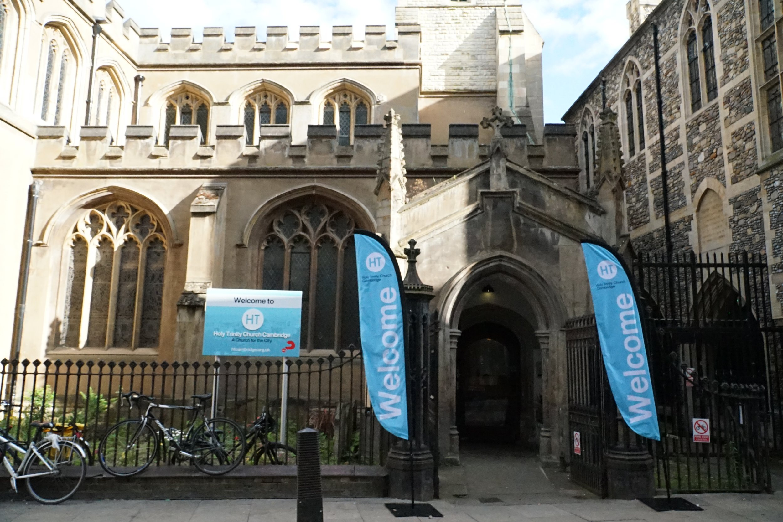
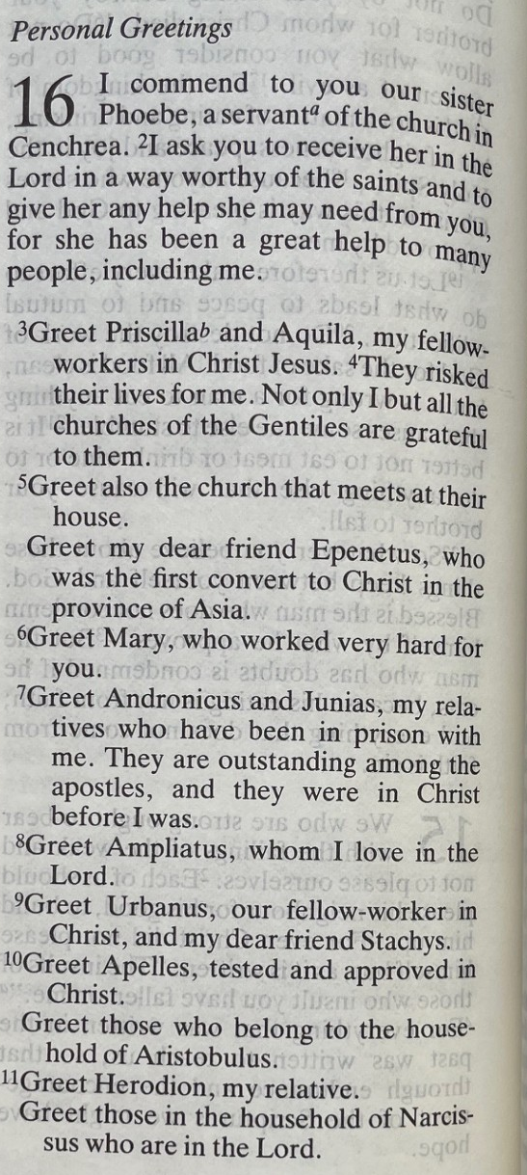
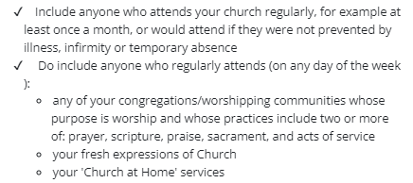
Q: “Worshipping community” isn’t in my register. How do I work that one out?
A: For many, this is the fiddliest question to answer. It’s the number of people who worship regularly (once a month or more), with any of your congregations/worshipping communities. I recommend making a list of names, reviewing it each year.
Notes:
N.B. Also includes online regulars. Schools are a bit of a grey area.

Slide 10

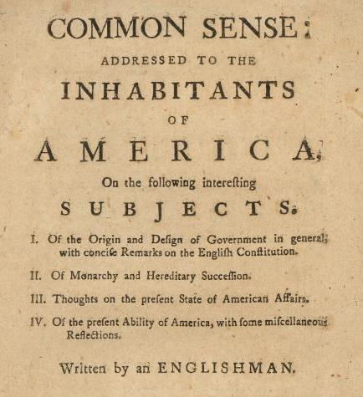
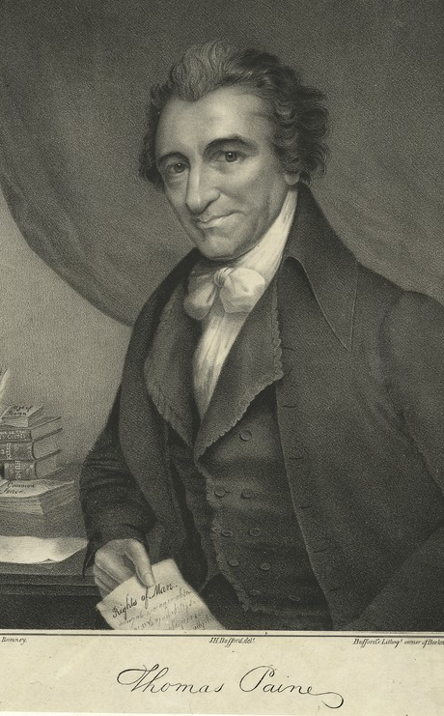
Q: If I’m not quite sure of the answer, what do I do?
A: Your common sense will probably get you to a sensible answer. I would far rather have your best estimate than have no information.
Notes:
If I don’t have your estimate, people will have to make do with my estimate! Thomas Paine 1776

Slide 11
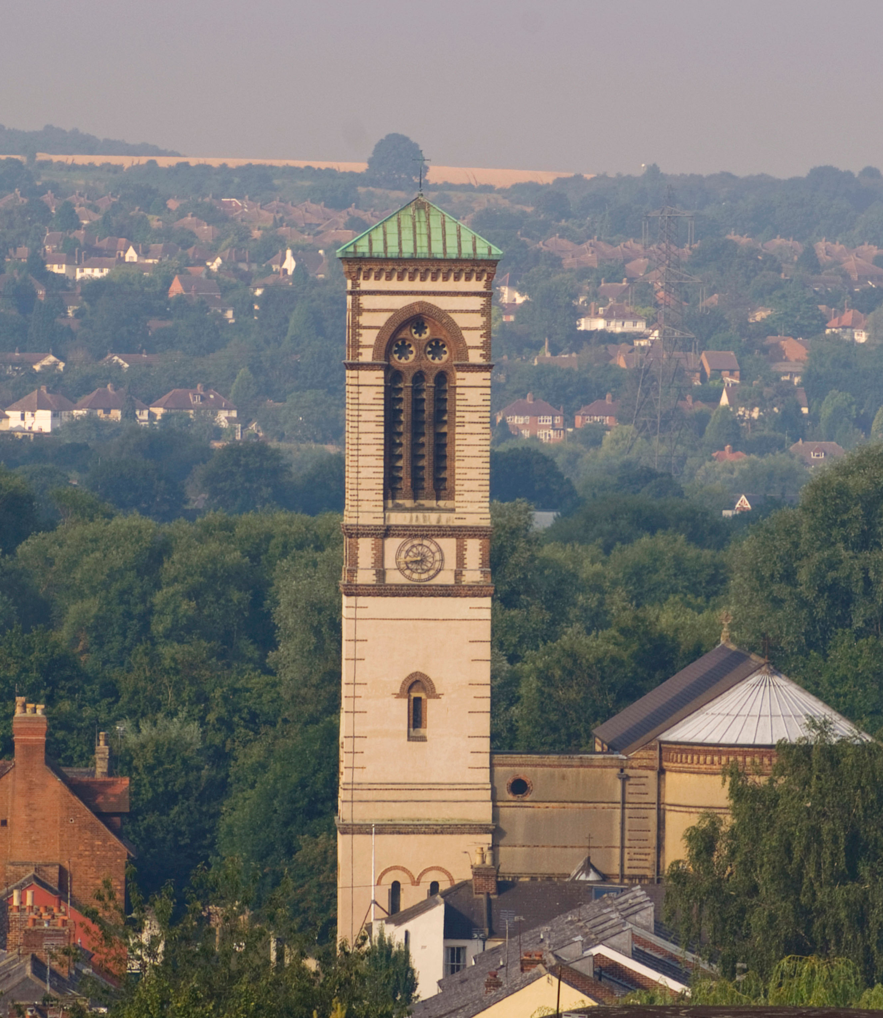

Q: What if I need help?
A: Please ask. Contact your diocese, or contact us: statistics.unit@churchofengland.org

Slide 12
Some of the ways the information is used
Introduction
Quantitative to Qualitative – PRAY
What are the learnings?
How can the stats impact the stats?
Definitions? Worshipping Communities
This all leads to how we can support the work of the church better.

Slide 14
Any questions?

Slide 15
What the online parish returns system can do for you
Almost all data we receive from churches comes via the Online Parish Returns System (OPRS).
It’s been around for the past 12 years or so, and can be found here: https://parishreturns.churchofengland.org/ Ideally, several people in every church and every diocese would have access to it.
Churches can enter their October attendance figures in (almost) real time.
It gives:
Access to “live” dashboards – Statistics for Mission, Parish Finance, and Census & Deprivation.

Slide 16
Census and deprivation data links
Interactive census & deprivation map: http://arcg.is/1RaS4CS
Big spreadsheets: https://www.churchofengland.org/about/data-services/resources-publications-and-data
Parish census & deprivation dashboards: https://parishreturns.churchofengland.org/census-dashboards/
User guide for the online map: https://www.churchofengland.org/sites/default/files/2024-05/parishmapsarcgis_userguide_april2024.pdf

