Slide 1
Doubling the number of children and young active disciples in the Church of England by 2030 is the first stated bold outcome of the Vision and Strategy.

Slide 2
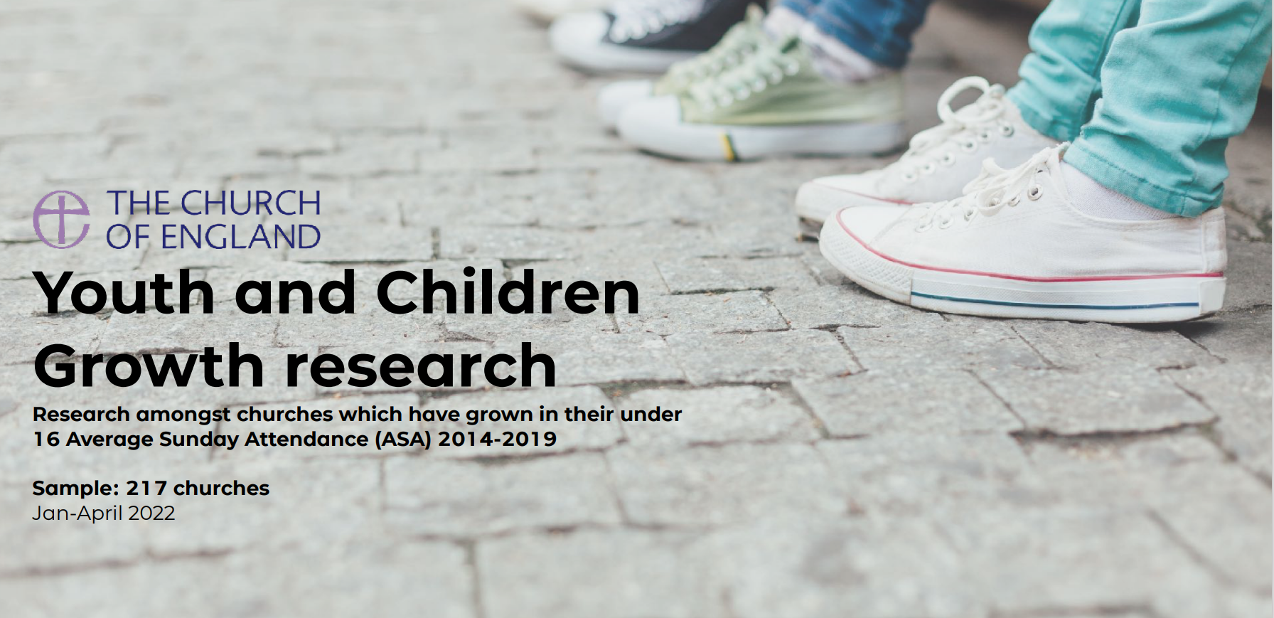
Youth and Childrens Growth research (churchofengland.org)

Slide 3
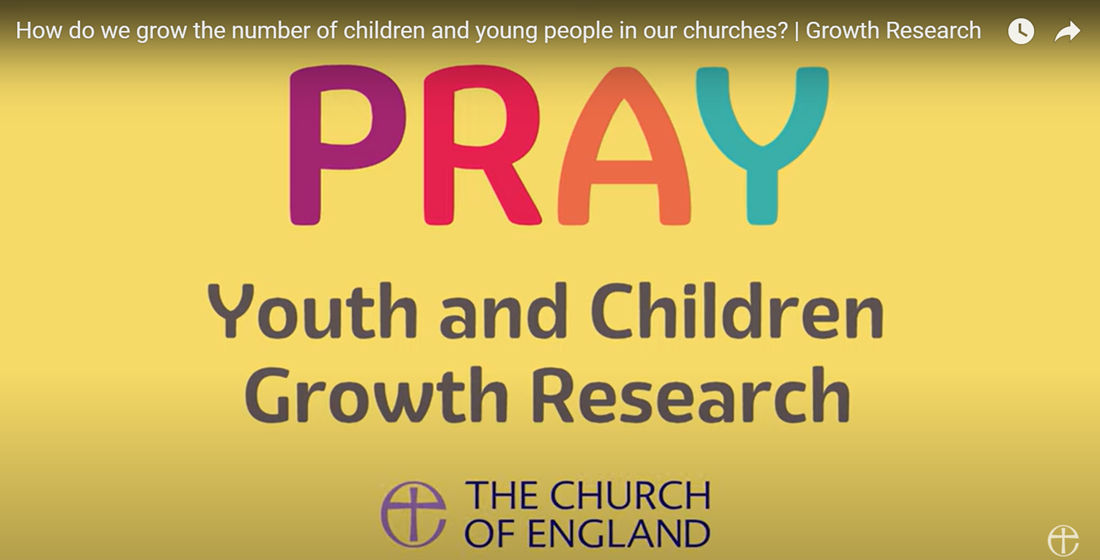
https://www.youtube.com/watch?v=u_1bvj7XXe0

Slide 4
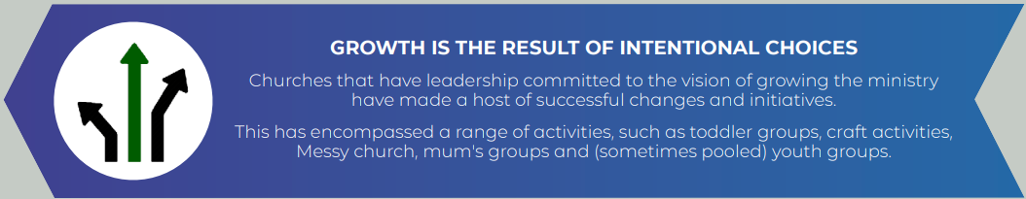
Resource

Slide 5
Growth is happening in a variety of contexts
Prayer underpins all growth
Intentional leadership is key
Growth comes when there is a focus on family and community rather than on one particular demographic group
Partnerships enable growth

Slide 6
Growth is happening in a variety of contexts
Church planting works in enabling rapid growth over a short period of time but is not the only route to growth

Slide 7
Prayer underpins all growth
Prioritising starts with prayer.

Slide 8
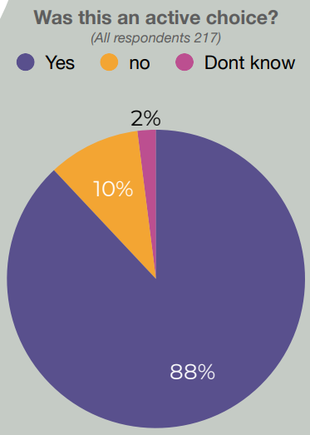
Intentional leadership is key

Slide 9
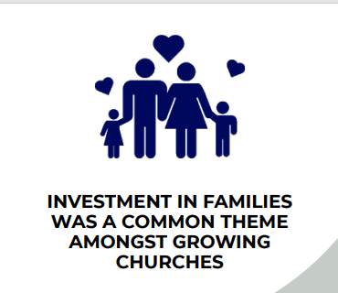
Growth comes when there is a focus on family and community rather than on one particular demographic group

Slide 10
Partnerships enable growth

