Slide 1


Slide 2

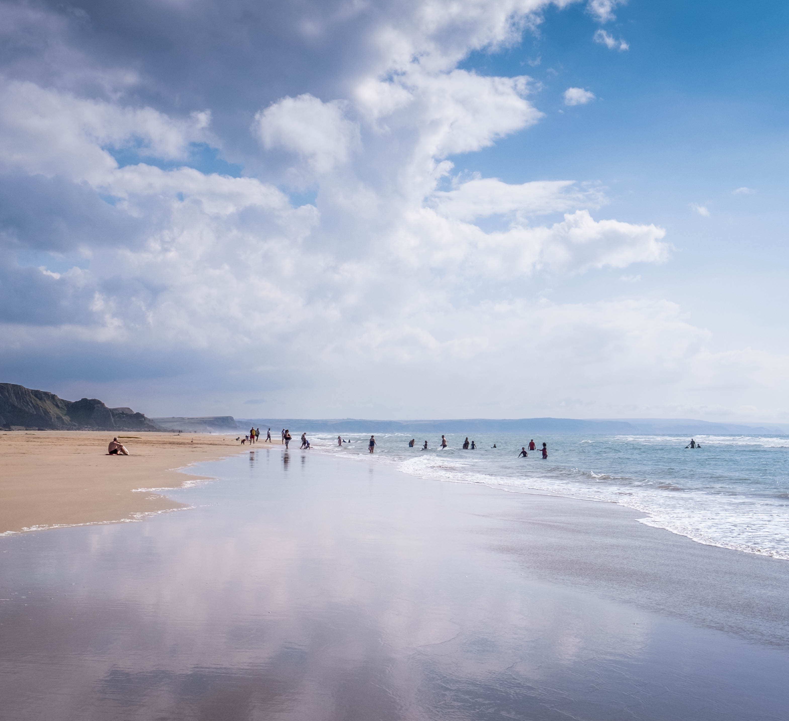
Please drag and drop your
alternative photo into this space

Slide 3

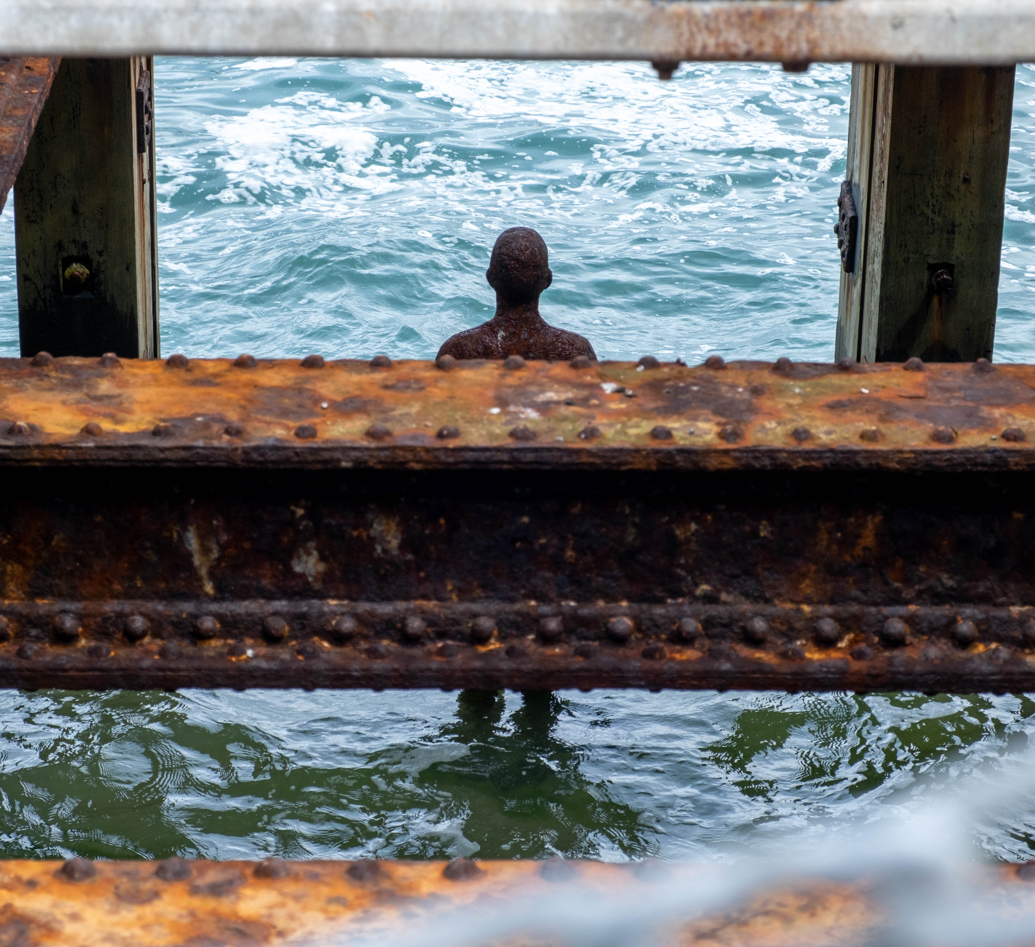
Please drag and drop your
alternative photo into this space

Slide 4


Please drag and drop your
alternative photo into this space

Slide 5


Slide 6


