Slide 1
Bereavement ministry:
An ongoing concern
Welcome to this webinar
10.00 – 11.00am Wednesday 21st April 2021
with Canon Sandra Millar Head of Life Events
and Katy Tutt from Loss and Hope

Slide 2
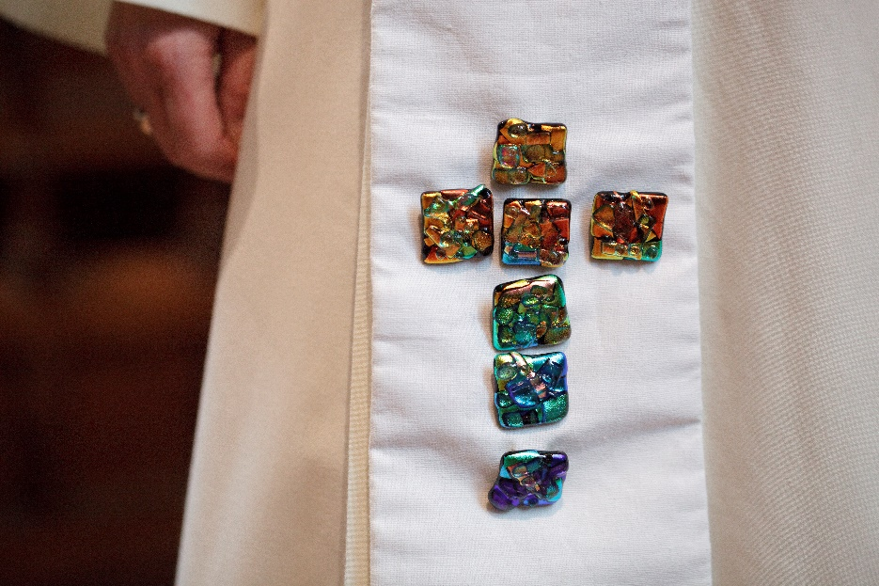
Everyone’s ministry
Our vocation
Our experience
Our heritage
Our Gospel
Do what you can..

Slide 3
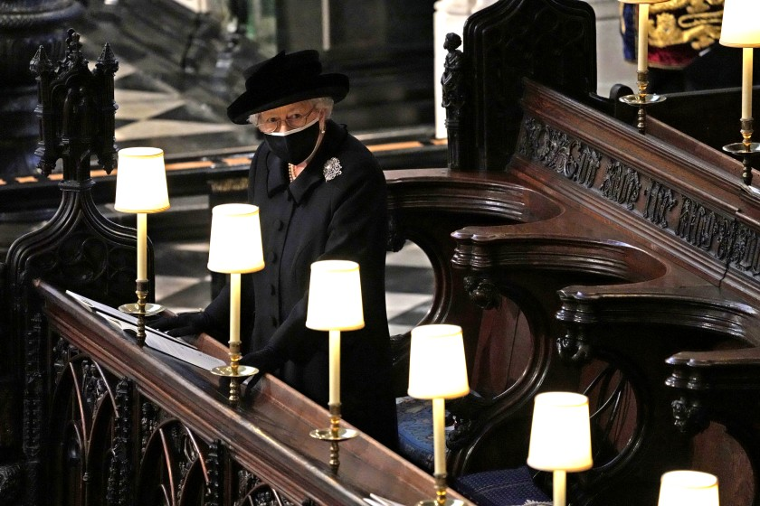
Life events:
A child arrives - christenings
A marriage begins - weddings
A life ends - funerals
Grief and remembering?

Slide 4
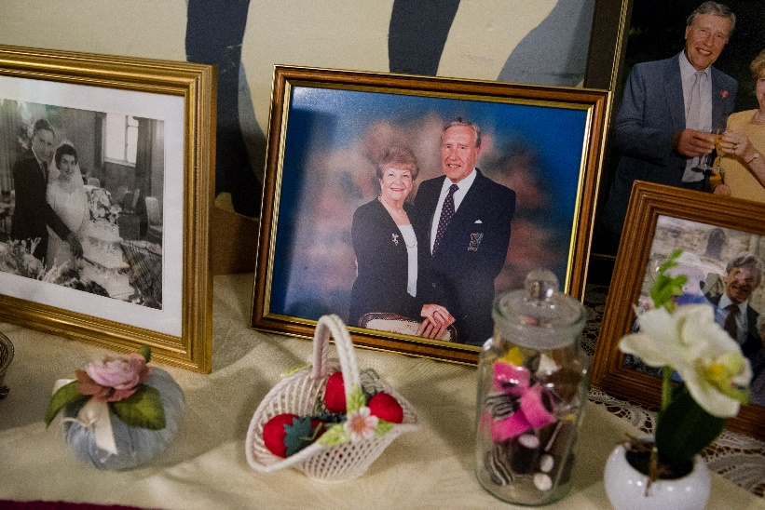
Bereavement matters
It’s who we are: Scripture, structure, vocation
The difference we make: wellbeing and family life
“ This is a time of great dying and the church should be right in the thick of it helping all who need help – in any way they can”
Research respondent 2021

Slide 5
All the people…
Who do we want to minister to:
Those for whom we take funerals?
All those who are bereaved?

Slide 6
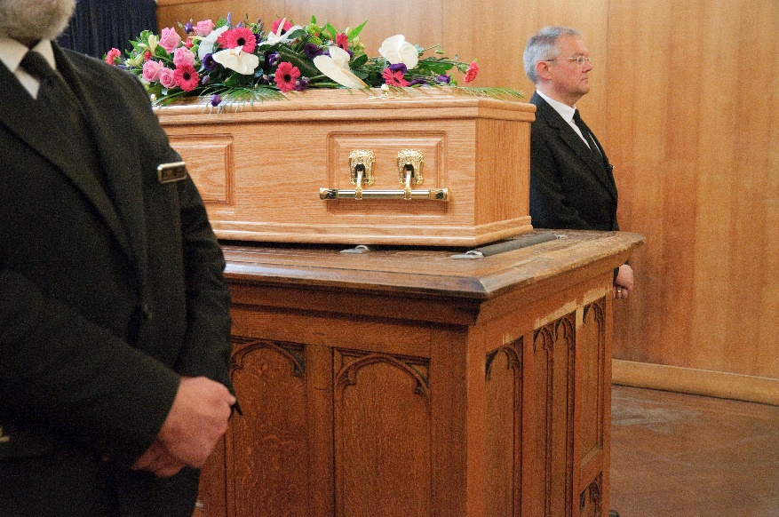
Numbers:
Total deaths in 2020: 570,000 [2019: 512]
In 2019: the CofE conducted 115,550 funerals [-22%]
-35% decline in crematoria funerals
Over 91% have experienced the death of someone in the past 5 years

Slide 7
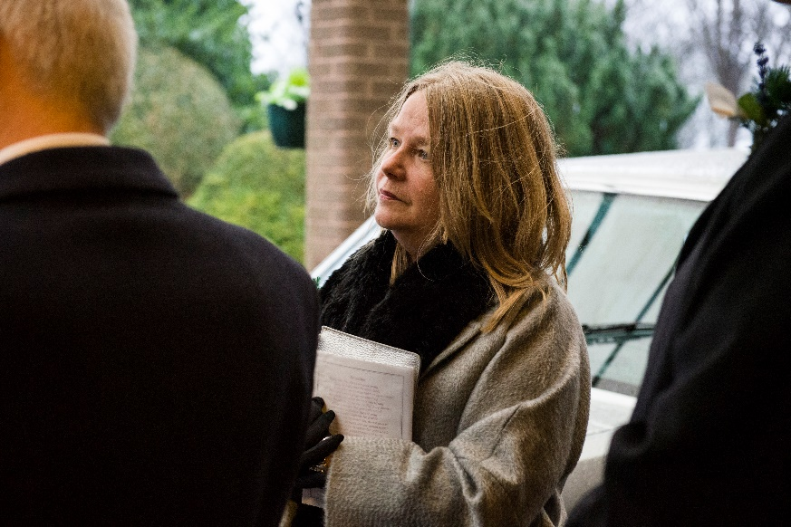
Impact of the pandemic
On grief:
62% (over 25 million people) have experienced the death of someone
27% (over 11 million people) have experienced the death of more than one person.
On Funerals:
Over 600,000 have had restricted funerals

Slide 8
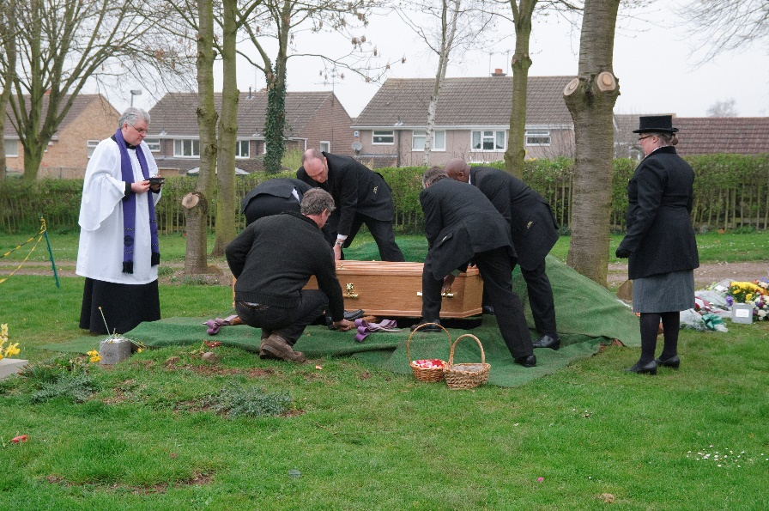
Restricted funerals:
7 in 10 of those who experienced someone’s death were not able to attend funerals
More than 8 in 10 agreed people haven’t been able to say goodbye properly or fulfil funeral wishes
4 in 10 said funerals were live-streamed
In past 12 months around 600,000 restricted funerals

Slide 9
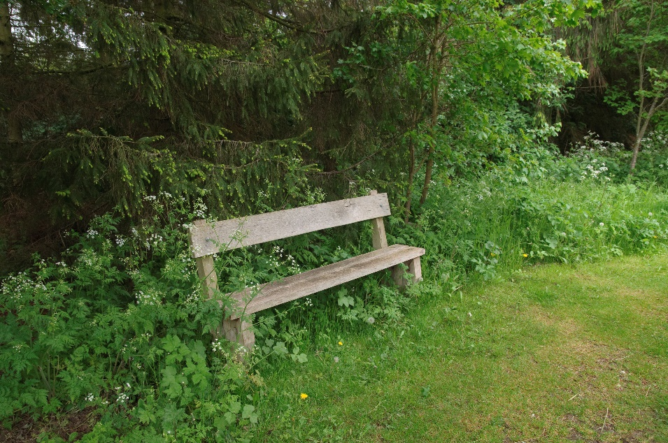
Restricted grief:
Lonely last days – manner of dying
Social isolation - escape, audience
Comfort and consolation
Missed moments – birthdays etc
Every death connects – pets and public
Loss, disappointments – big and small
Delayed reactions – now we notice

Slide 10
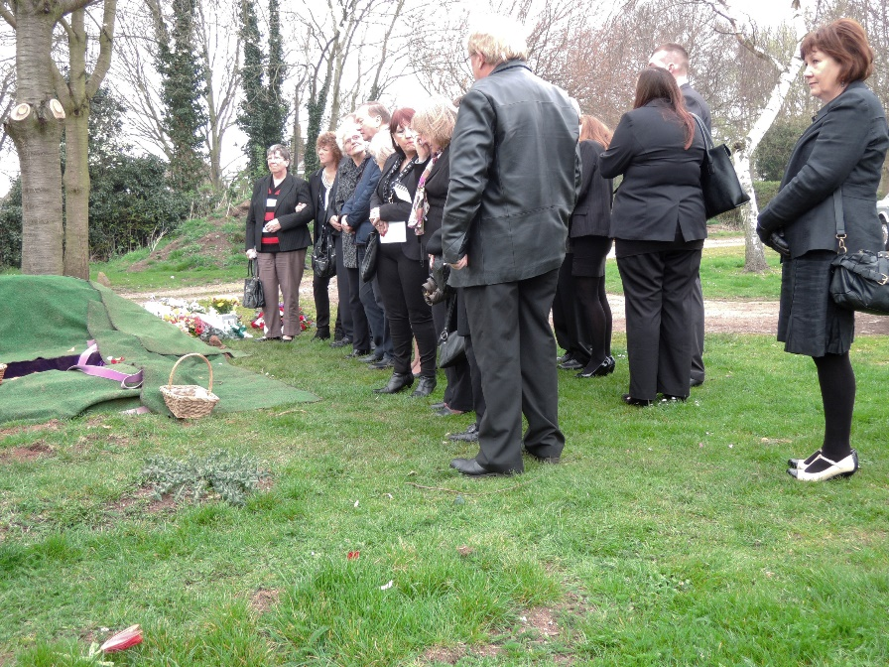
People: bereaved?
NB: 80% of deaths are over 75
Baby boomers - planning and grieving
Gen X – organising and grieving
Millenials - grieving grandparents
Gen Z - first grief experiences
Relatives, friends, neighbours, colleagues

Slide 11
Impact on young adults
5 in 10 18-29s lost someone close to them, compared with 3 in 10 of those 60+
More than half helped someone cope with bereavement, compared with 1 in 4 of those 60+
1 in 4 were involved in arranging funerals, compared with less than 1 in 10 of those 60+
It has been hard thanks to Covid, I almost felt like covid hanged over the death of my grandfather. It was not a death caused by Covid but covid ruined the day - having to wear a mask, feeling guilty about cuddling people, the wake. This has impacted on my mental health immensely

Slide 12
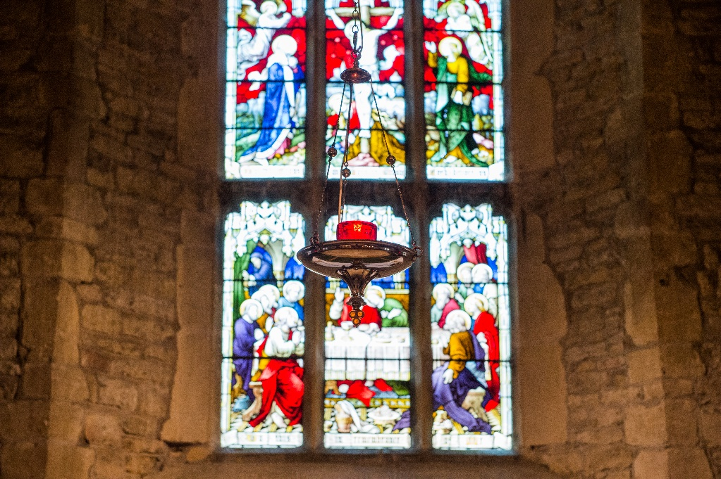
Grief and church:
The two main things expected
Places to go for support, reflection
People to hear and hold stories
It would be amazing if there were support groups and more help when dealing with grief. I also feel this would encourage more people to join their church later down the line. We don’t forget those who help us at our darkest times.

Slide 13
Helping together:
Holding services –
frequency and focus
your place or theirs
Creating memorials
Making spaces
Naming the needs

Slide 14
Helping individuals:
Digital spaces - www.ataloss.org
candles and condolence
Church services – memorials, worship
Church spaces – prayer points
Contact – being in touch, visits
Listen – stories, needs and limits
Bless - kindness

Slide 15
The Bereavement Friendly Church
Katy Tutt from Loss and Hope
Notes:
But music isn’t the only choice that will need to be made..

Slide 16
Response:
Prayer
Enable others
Enhance skills
Contact and communicate
Planning next steps
Notes:
But music isn’t the only choice that will need to be made..

Slide 17
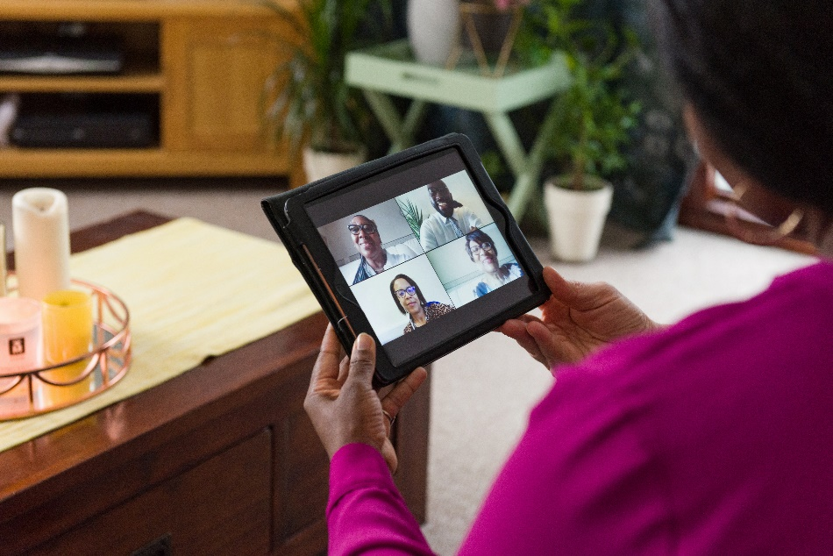
Challenges: communication
Where – online, physical
Who – FDs, families
What - information
How - what can we offer you?
Notes:
But music isn’t the only choice that will need to be made..

Slide 18
Just ask
A campaign to tell people:
In our communities
In our buildings
Banners, information and more.
Notes:
Explaining what’s available

Slide 19
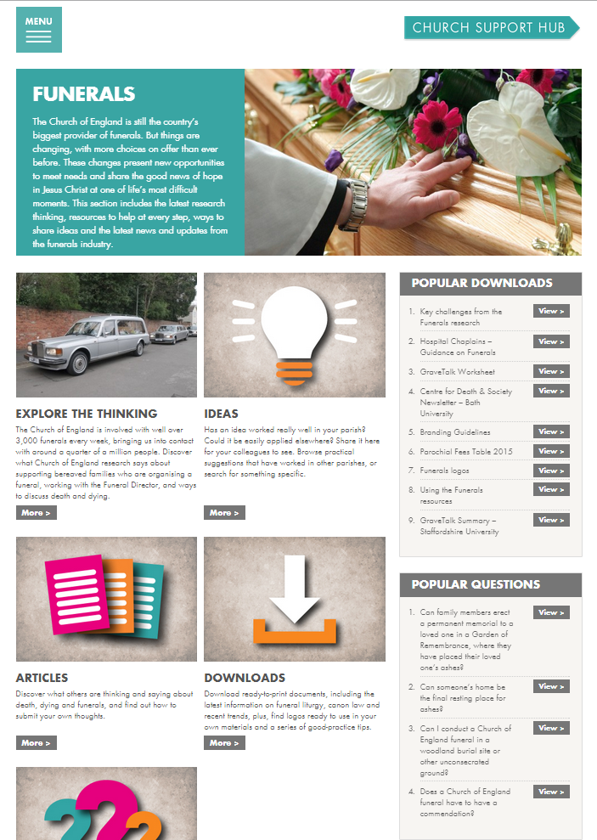
ChurchSupportHub
Information
Insights
Ideas
Downloads
Notes:
This is the main place to get help and information, and to share good practice.

Slide 20
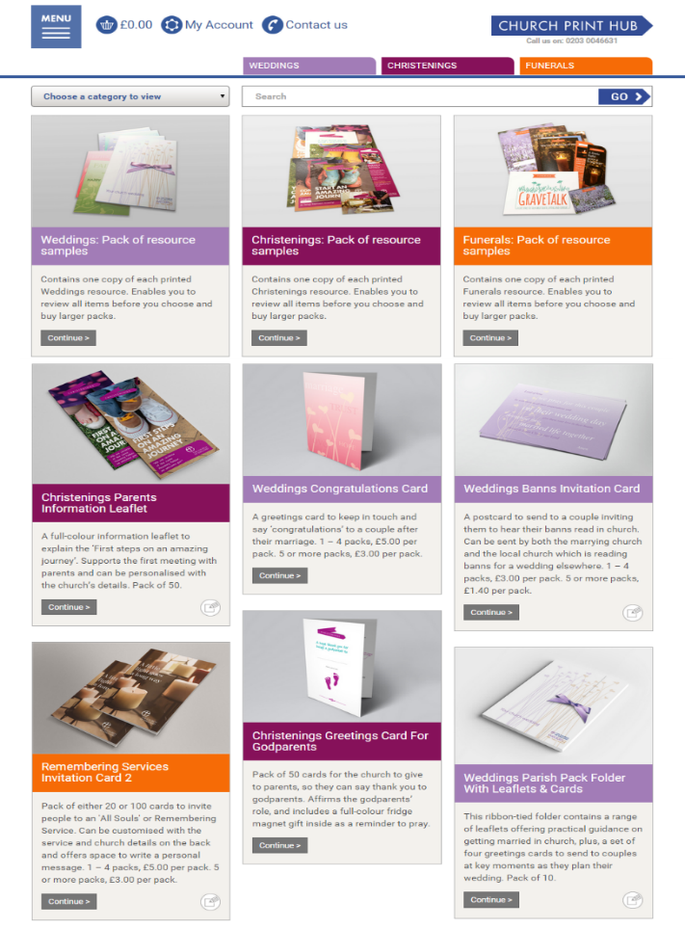
ChurchPrintHub:
An online shop
Choose
Order
Customise
Delivered
Notes:
The print hub is where to buy all the weddings materials as well as other resources

Slide 22
Questions

Slide 23
Thank you
Our next webinars:
11.30- 12.30am 14th May 2020 - Remembering
Registration now open
WELCOME

