Slide 1
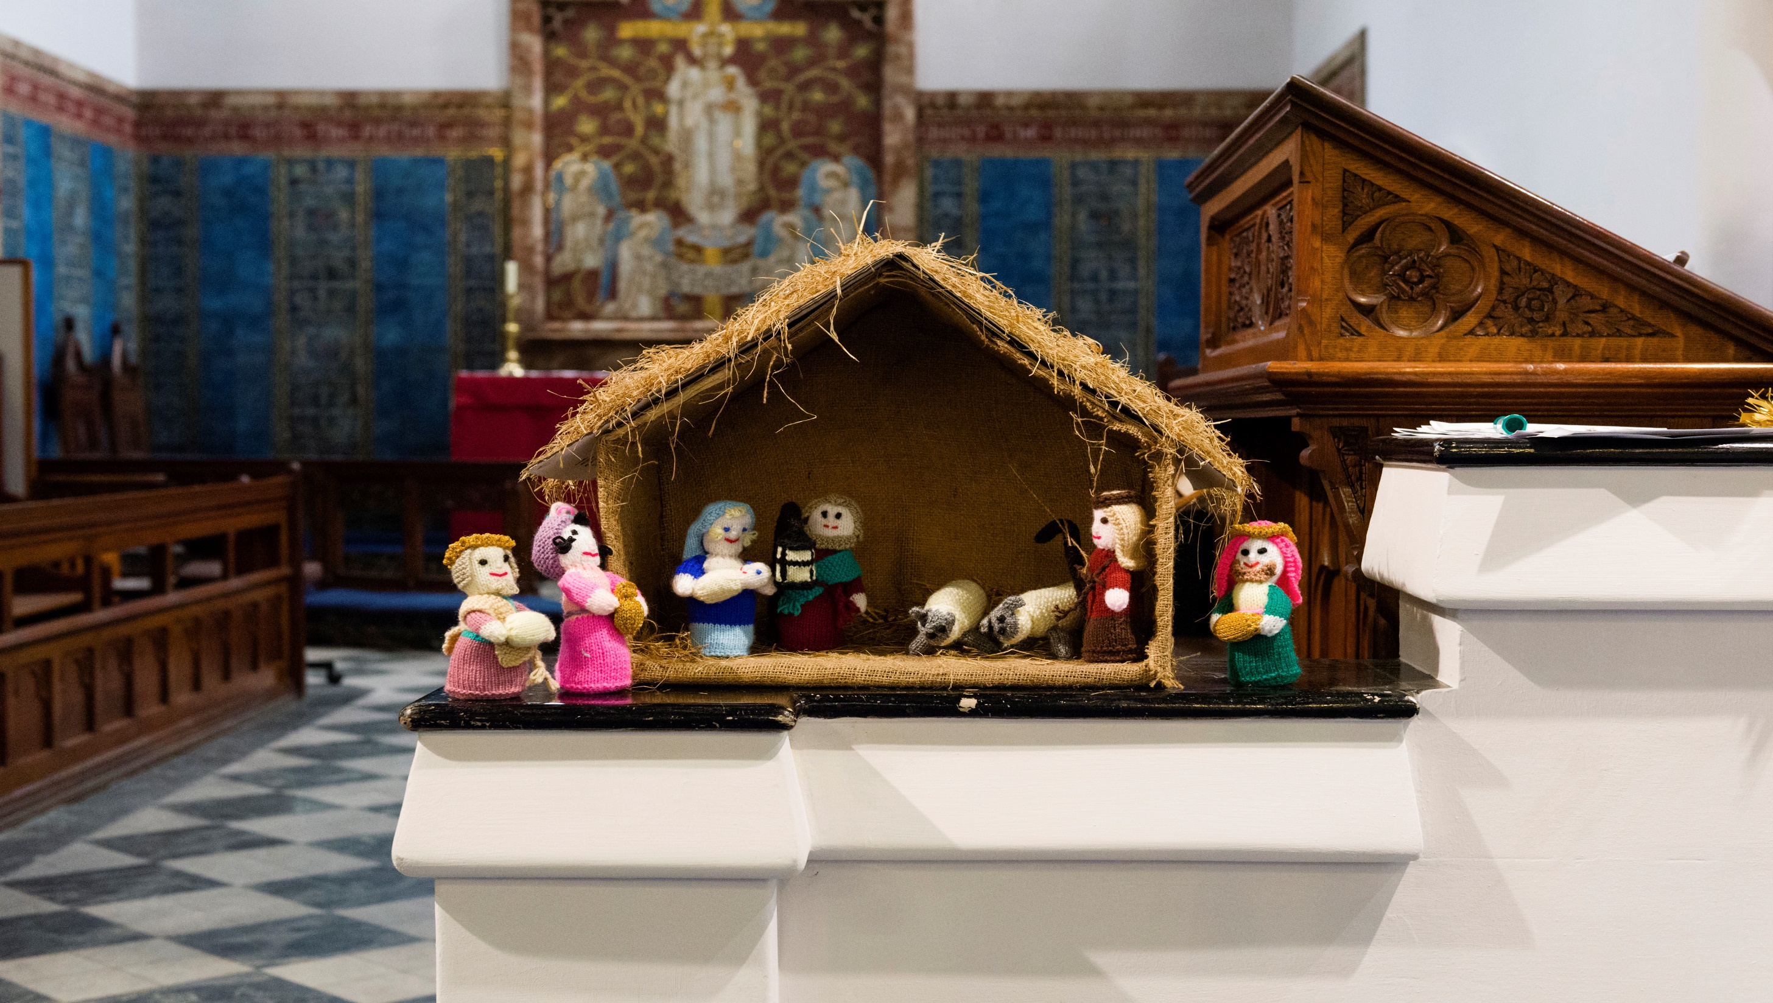
Framing memories: Christmas
with Canon Sandra Millar Head of Welcome and Life Events

Slide 2
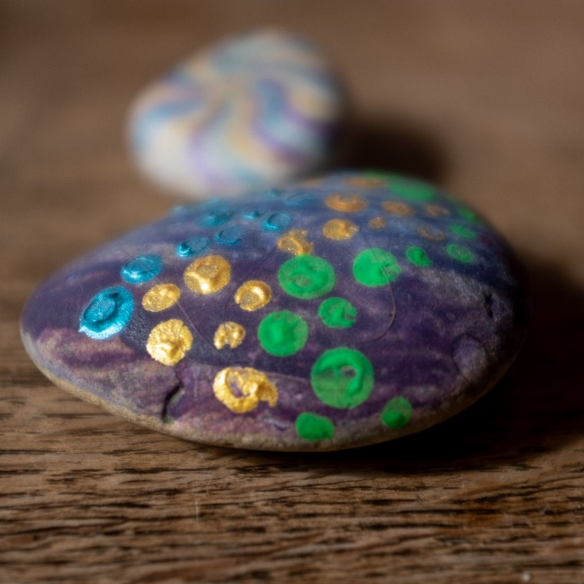
Core intentions:
Comfort and Joy
Affirmation
Confidence
Inclusion
Art of the possible
Becoming “memory makers”
Notes:
I will welcome and introduce myself and the topic, before going through the things we are going to cover.

Slide 3
What we will cover:
Where we are now
Welcome and purpose
Frameworks
Communication
Practical ideas
Questions:
please enter any time during the webinar
Notes:
I will welcome and introduce myself and the topic, before going through the things we are going to cover.

Slide 4
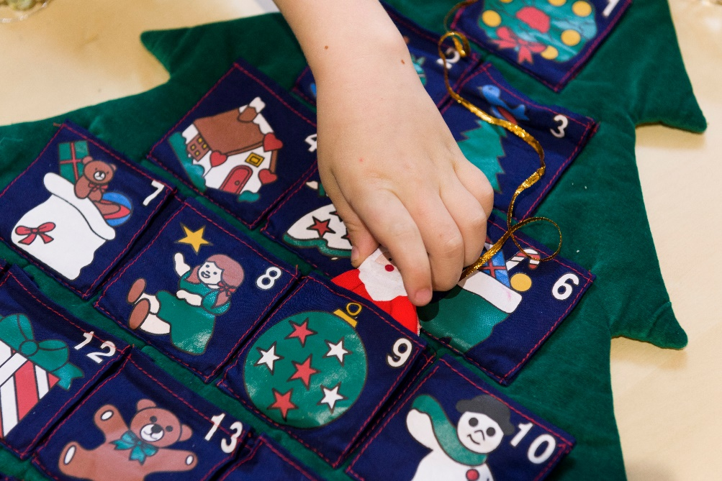
Christmas is not cancelled…
Context
Communication
Welcome
Delight
Expectations
Different is not worse
Notes:
Talking about the stage we have now reached when people are coming back after the lockdown – how we need at attitude of confident, joyful welcome. Reminder that every context is about safety – not just church. What expectations do we have, and what do those who come to us have? And what will be same for people – excitement, celebration, marking a life change

Slide 5
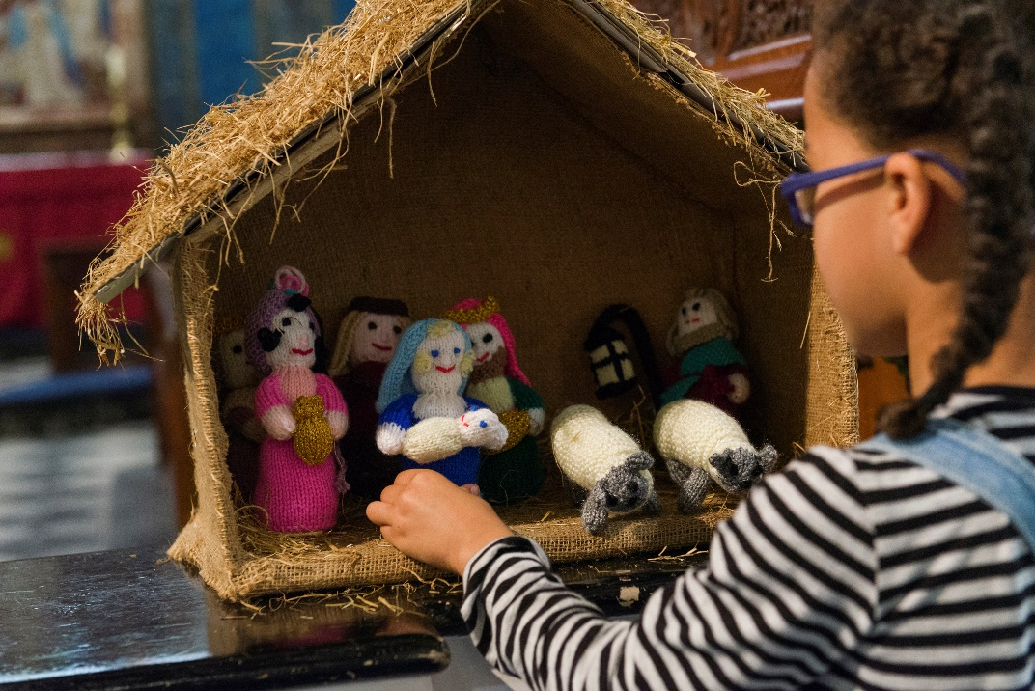
So why does it matter?
Touch point for thousands
Gives meaning
Sharing virtues
Brings hope
The heart of the Gospel
Notes:
Talking about the stage we have now reached when people are coming back after the lockdown – how we need at attitude of confident, joyful welcome. Reminder that every context is about safety – not just church. What expectations do we have, and what do those who come to us have? And what will be same for people – excitement, celebration, marking a life change

Slide 6
Who?
Regular regulars
Irregular regulars
Partner organisations
Care homes
Bereaved people
New family groups
Those alone for Christmas

Slide 7
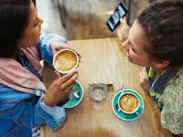
Boxing day and beyond:
Where will you see each other again?
Who will follow through?
Church
Community
Practical help?
On-line
Physical space
Mid-week
For a coffee?

Slide 8
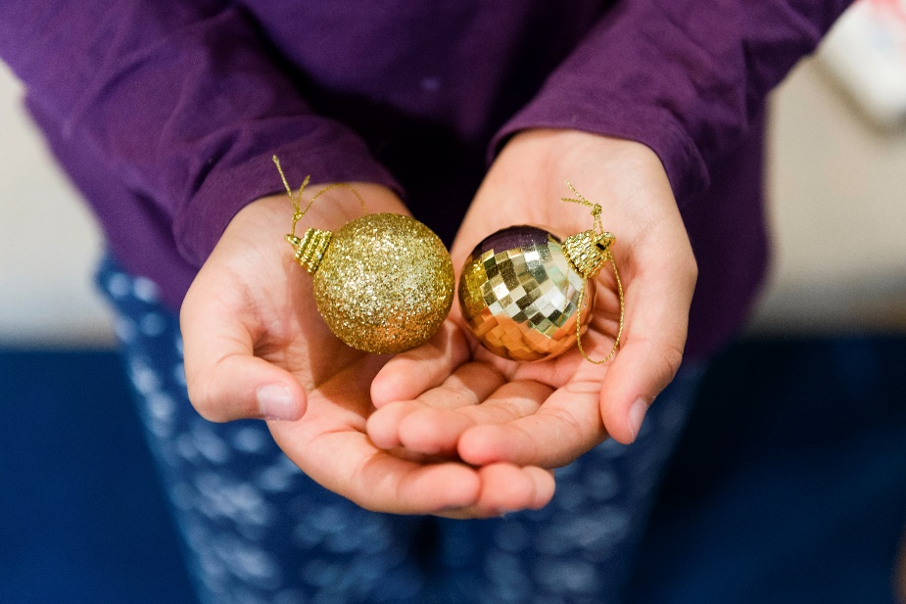
What: focus
‘Services’ – thinking differently
Physical – indoors, outdoors
Digital opportunities
Domestic spaces
Do two things well

Slide 9
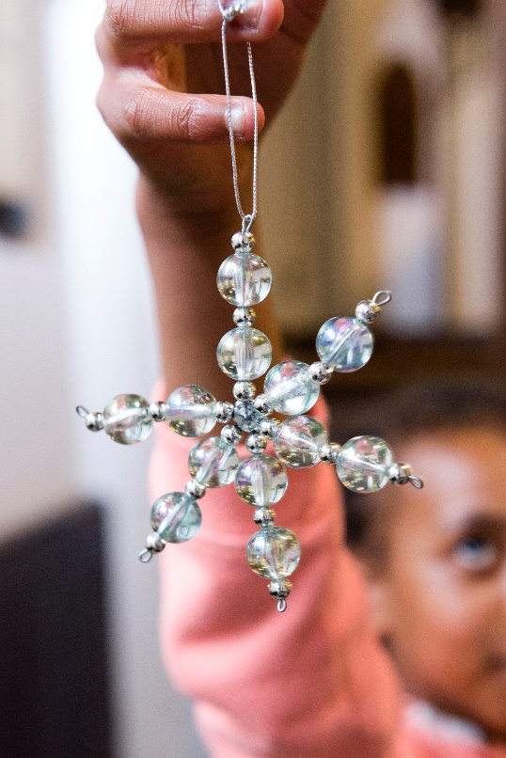
Moments and memories
Trees and lights
Symbolic actions
Cribs and the real story
Silence and stillness
Traditions – music, words

Slide 10
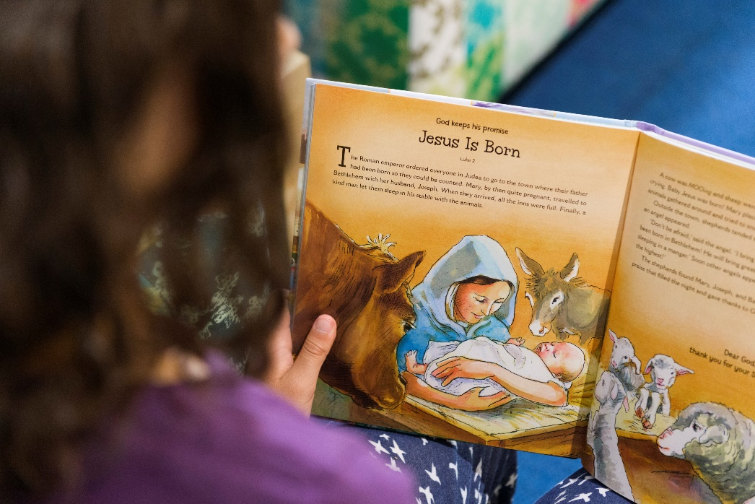
Spaces: digital and domestic
On-line – digital/social
Broadcast – audio/TV
Prayer in the home/work
Activity in the home/work
Shared moments
Letter-box post

Slide 11
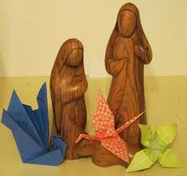
Spaces: outdoors
Prayer spaces
Trails and hunts
Windows and walks
Posada
To the people..
Multi-media echoes

Slide 12
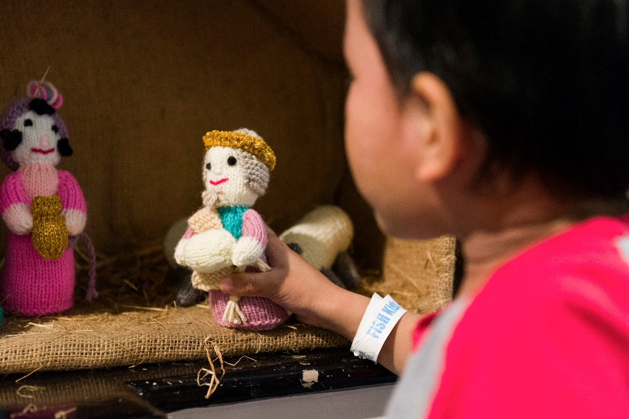
Spaces: indoors
Familiar services
Audiences
Moments of joy
Moments of comfort
Multi-media echoes

Slide 13
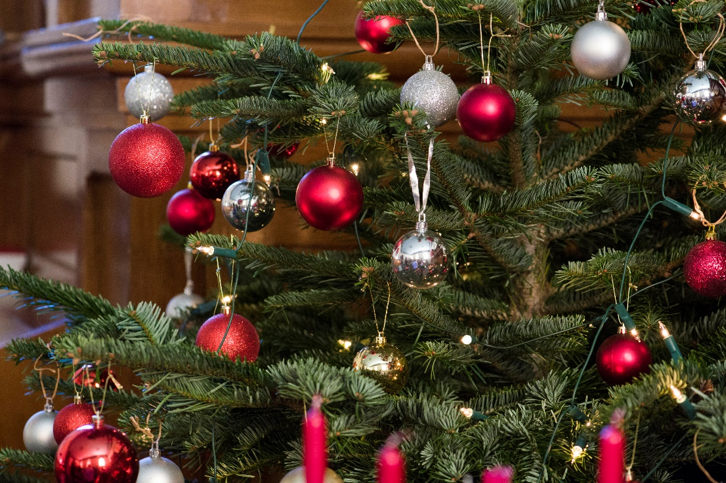
Spaces: communal
Local partnerships
Shared moments
Creativity and skill
Participation
Joy – excitement
Comfort - realism
Cultural awareness

Slide 14
Communication:
Where?
How?
What?
Information
Invitation
Continued - relationship

Slide 15
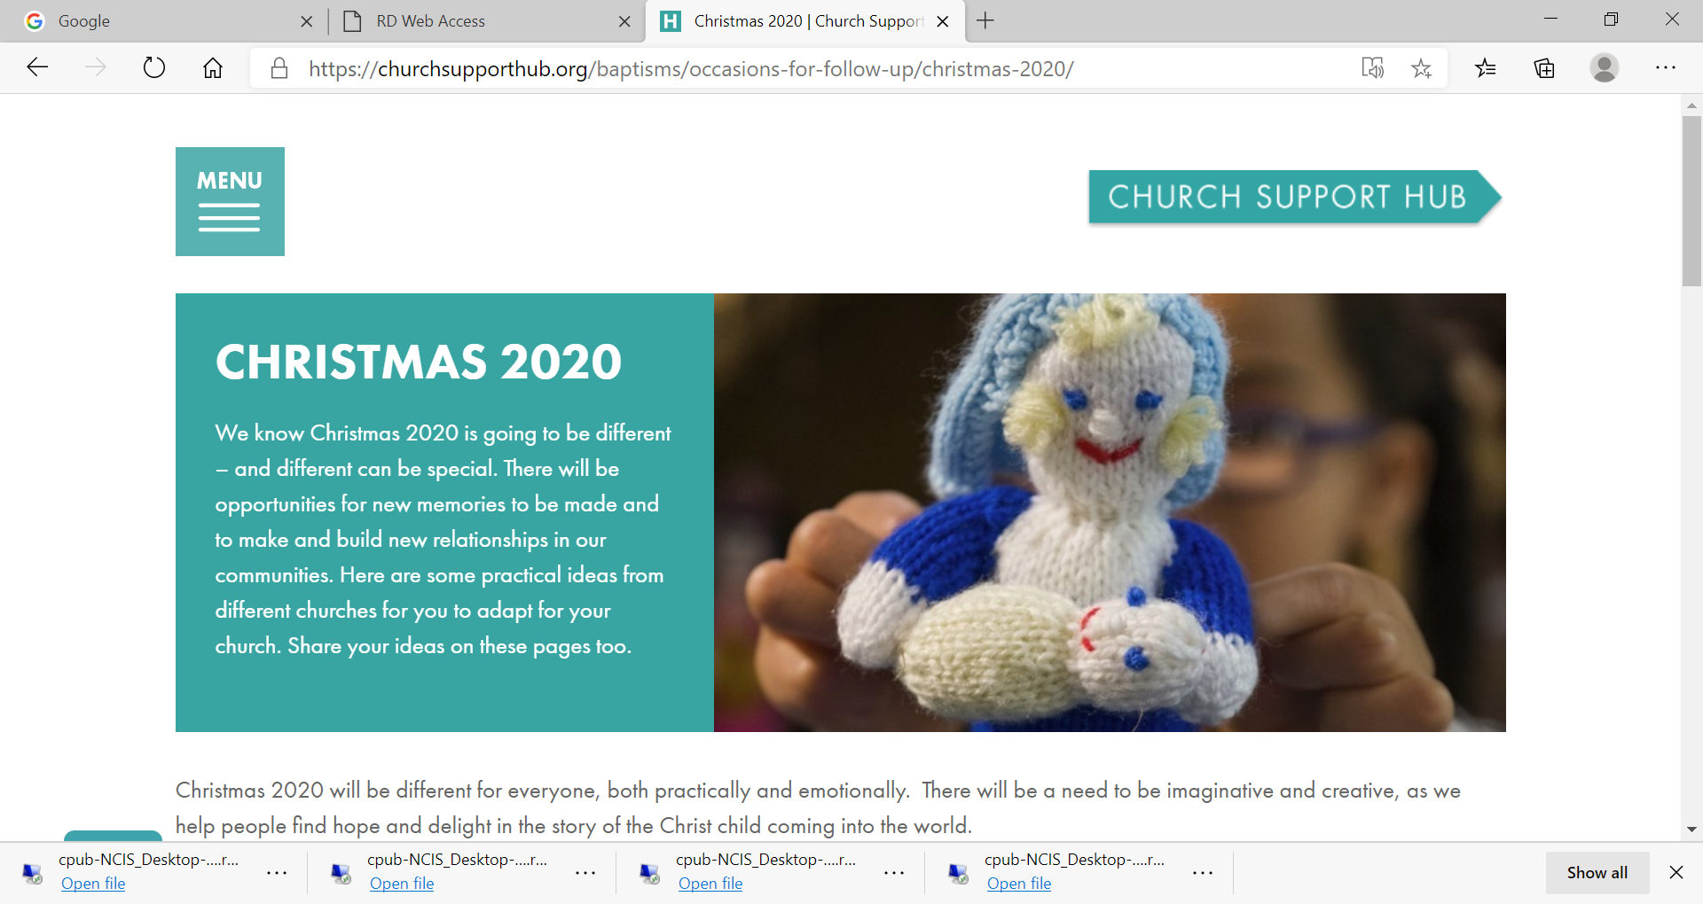
Churchsupporthub:
Churchsupporthub/christmas2020
Information
Insights
Ideas
Free Downloads
Notes:
The print hub is where to buy all the weddings materials as well as other resources

Slide 16
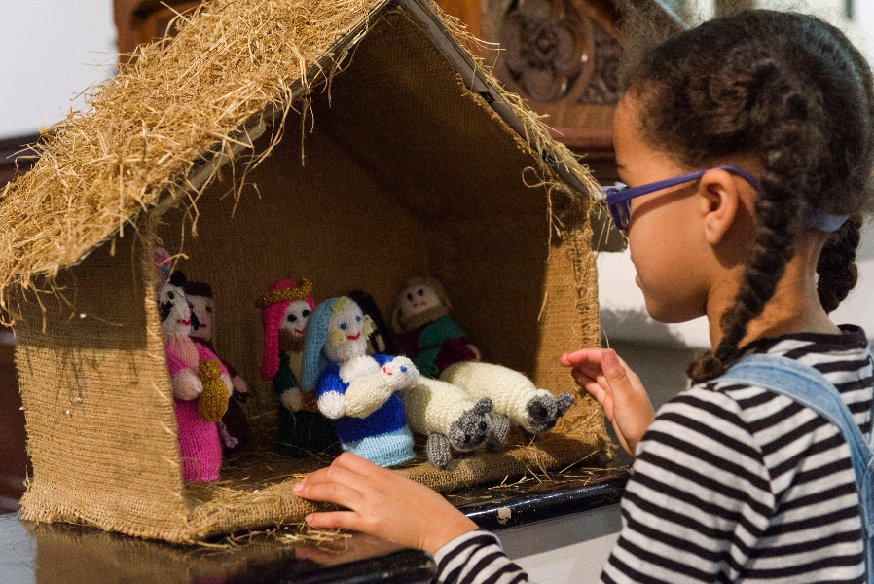
Core intentions:
Confidence – we have a message
Affirmation – you are doing a great job
Reassurance – you can do this
Art of the possible – gathered will be the bonus
Becoming “memory makers” - it’s not about disappointment but about delight
Notes:
I will welcome and introduce myself and the topic, before going through the things we are going to cover.

Slide 17
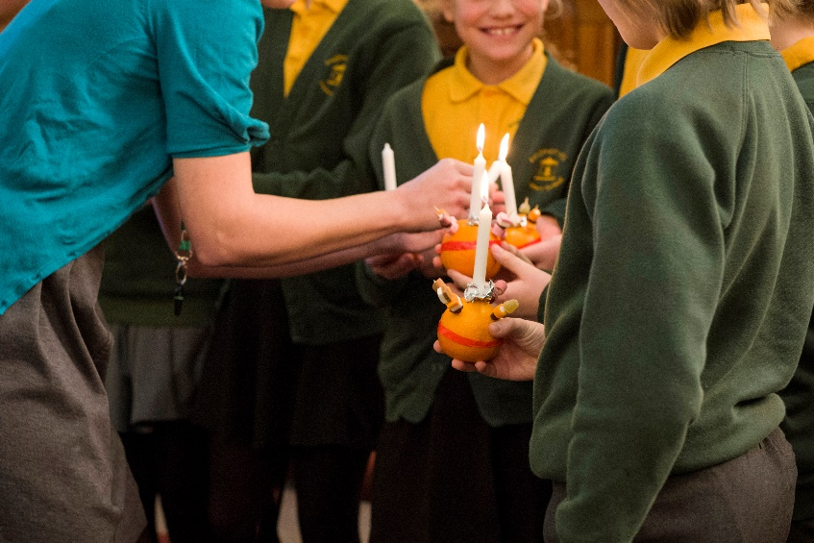
Ideas and resources:
Comfort and Joy
A church near you
Good ideas: Emma

