Slide 2
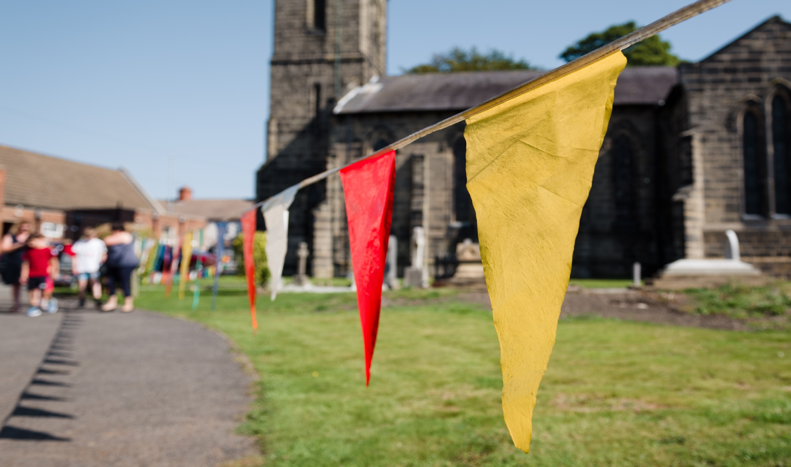
Come back after:
Weddings and Christenings
Welcome to this webinar
11.00 – 12.00 pm Tuesday 9th May 2020
with Canon Sandra Millar Head of Life Events
Notes:
Before we officially start I usually say ‘hello’ and similar things. We will start formally at about 11.03.

Slide 3
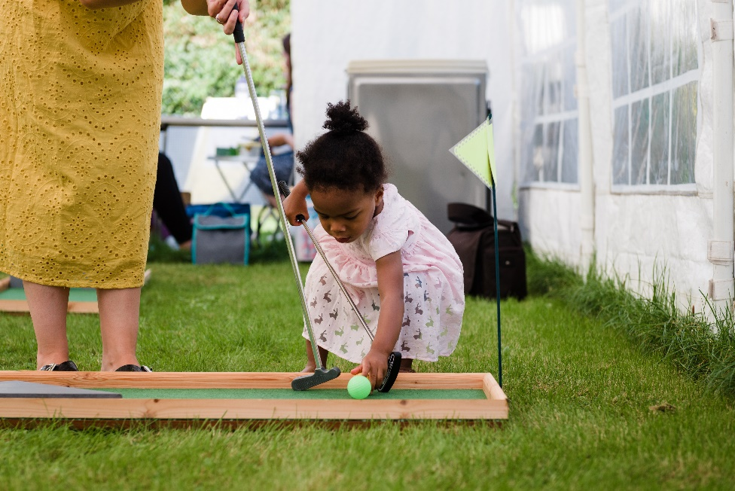
What we will cover:
Impact and scope
Making it special – relationships
Making it significant – moments that matter
banns
wedding
christening
After the day
Publicity
Please type questions in at any time during the webinar
Notes:
I will welcome and introduce myself and the topic, before going through the things we are going to cover.

Slide 4
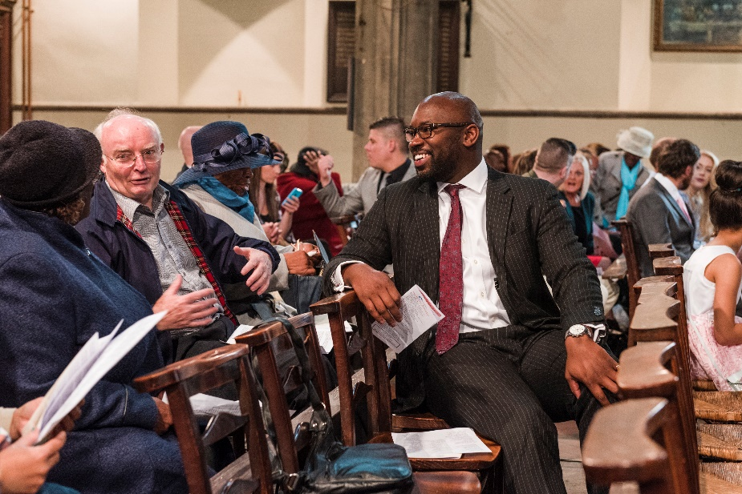
Impact and scope:
In 2018 Church of England conducted
35,000 weddings
Met 70,000 brides and grooms and 2.6 million guests
85,000 baptisms of a child
Met 500,000 parents, godparents, children and 4.3 – 6.4 million guests
What’s your first thought?
Who is your first thought?
Notes:
I will talk about the numbers of ceremonies – and the likely numbers that won’t happen this year.
Then I will explain the difference between warm contacts and wide contacts as I talk about those we have conversations with and those we meet as guests. People will be invited to comment in chat on the questions. I will make a couple of suggestions – such as ‘thank goodness’.. Or ‘how sad’

Slide 5
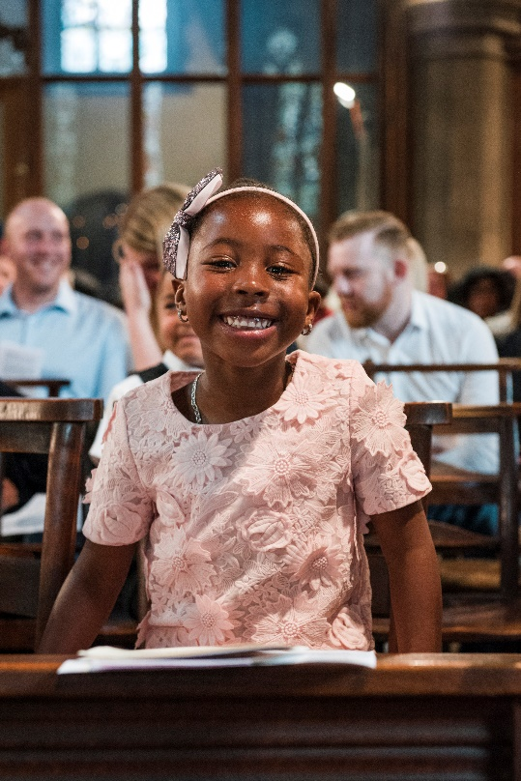
Come back after
Welcome
Delight
Safety
Expectations
Same.. yet different?
Notes:
Talking about the stage we have now reached when people are coming back after the lockdown – how we need at attitude of confident, joyful welcome. Reminder that every context is about safety – not just church. What expectations do we have, and what do those who come to us have? And what will be same for people – excitement, celebration, marking a life change

Slide 6
Just respond : warmth vs process
Anticipation and excitement | Trust and delight
Fear and anxiety | Reassurance and confidence
Warmth/relational
Process/transactional
Notes:
Before we go further, talk about this grid, which helps us frame the journey people are on. We want them to journey toward ‘trust and delight’

Slide 7
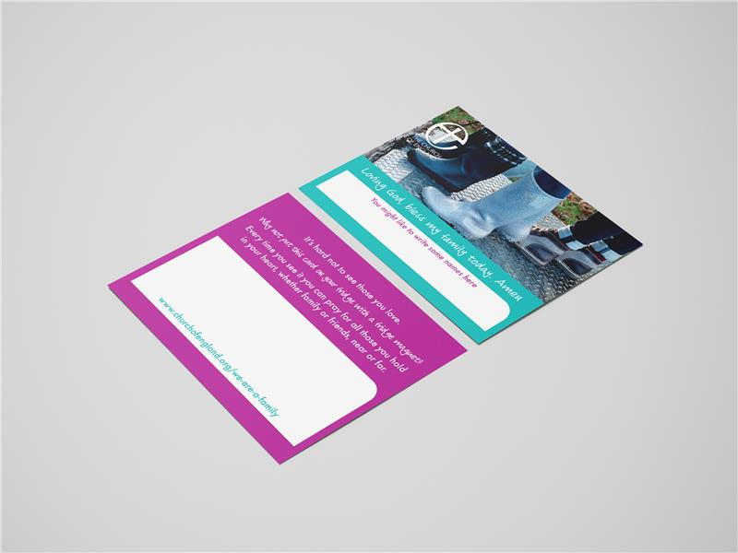
Special: relationship building
Stories – joy and sadness
Who? couples, families
Why and what? Information matters:
‘out of sight, out of mind’
When: as much as you can
How? Phone and post
On the day
Notes:
One of the key words people use to describe their special moment is special. So how do we make sure this different experience is still special. Stressing the importance of contact, good information – and listening.
Reinforcing the relationship happens on the day itself

Slide 8
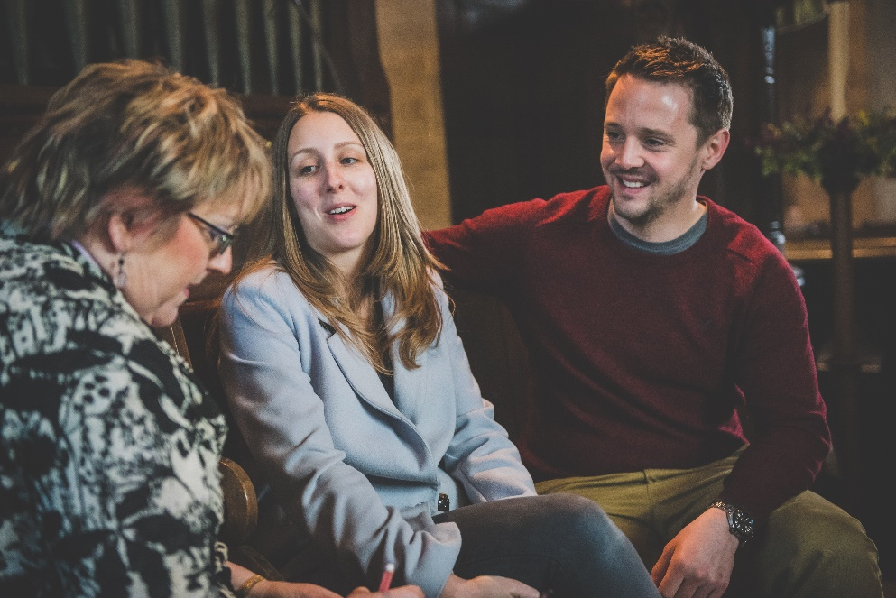
Significant: moments that matter
Banns and attendance:
Contact
Reassurance
Invitation
Welcome
Yourchurchwedding.org
Notes:
The other word people use a lot to describe the ceremony or service is the word ‘significant’.. Which is often the best word they have to describe a spiritual feeling or awareness. I will talk now about three different services in detail – banns, and attendance; the wedding day, and the christening.
Talking about why banns and attendance matter; high levels of anxiety – so contact really matters. Invite and welcome really matters too.

Slide 9
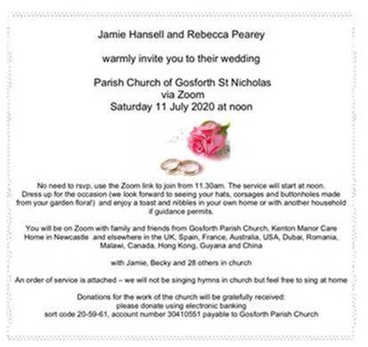
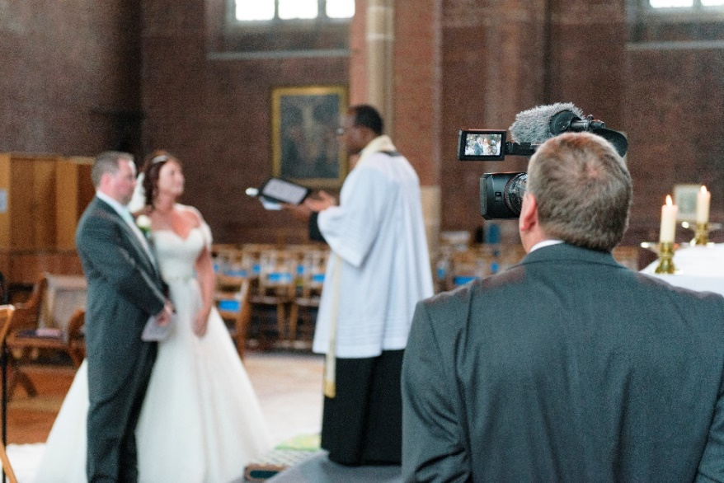
Significant: moments that matter
The Wedding Day:
Rehearsal
Entry - “Do you…”
Vows - and other words
Guests …
Exit - music, photos
What next?
Notes:
There are lots of special and significant memories from a wedding day – but research identifies 3: how you enter, vows, and leaving. I will talk about the different ways a bride can be accompanied down the aisle; then about the way the vows are special – voice and gesture; also where readings fit in. Then about music and the practicalities of leaving the space.

Slide 10
Significant: moments that matter
The christening day:
Getting ready - fears and hopes
Special people
Special moments – font, prayers, candle
Churchofenglandchristenings.org
Notes:
Moving on to christenings – talk about the ‘baptism prep’ stage, how to do this, how to listen to stories now and make connections. The importance of Godparents, and the three most important moments. Practical tips on oil, water and candles as well!

Slide 11
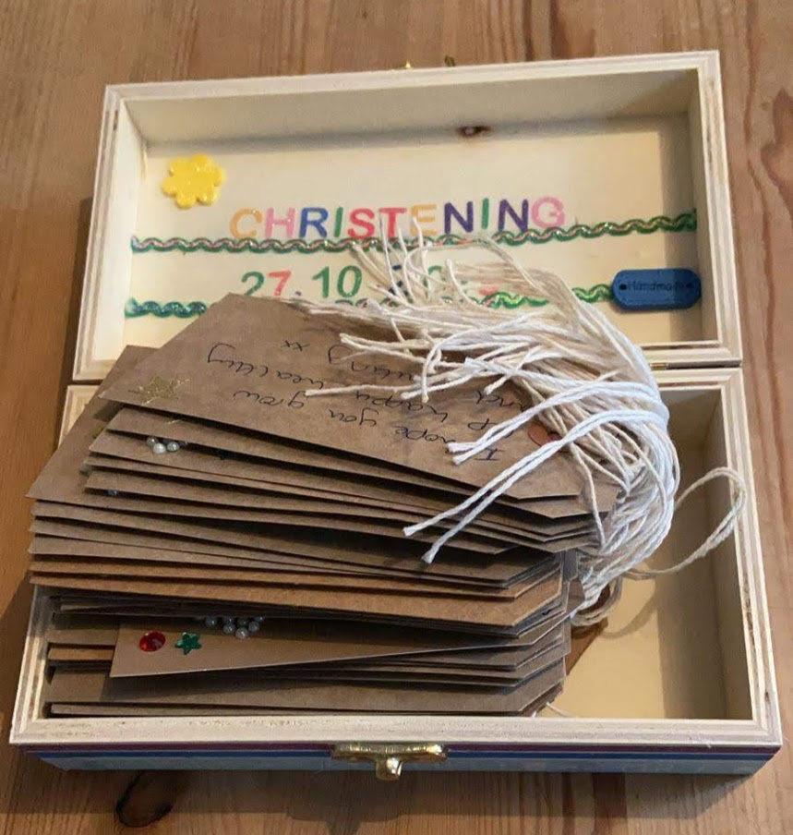
Significant: creativity
Using space – indoors and outdoors
Getting personal
Involving guests
Body language matters
Notes:
Talking about both weddings and christenings, the use of creativity even in these restricted times – just needs to be thought through. Being personal through prayers and gifts – going beyond the expected. And why smiling in your voice and body is important..

Slide 12
After the day
Keep in touch
Invite and inform
Welcome and include
Walk alongside
How then shall we live?
Notes:
Whichever occasion it is all the good work of relationship building, making it special and significant will be lost if we don’t keep in touch afterwards. Keep up curious conversation, make sure people know next steps, walk alongside, partnerships not dependency - giving practical ideas. Faith at home…

Slide 13
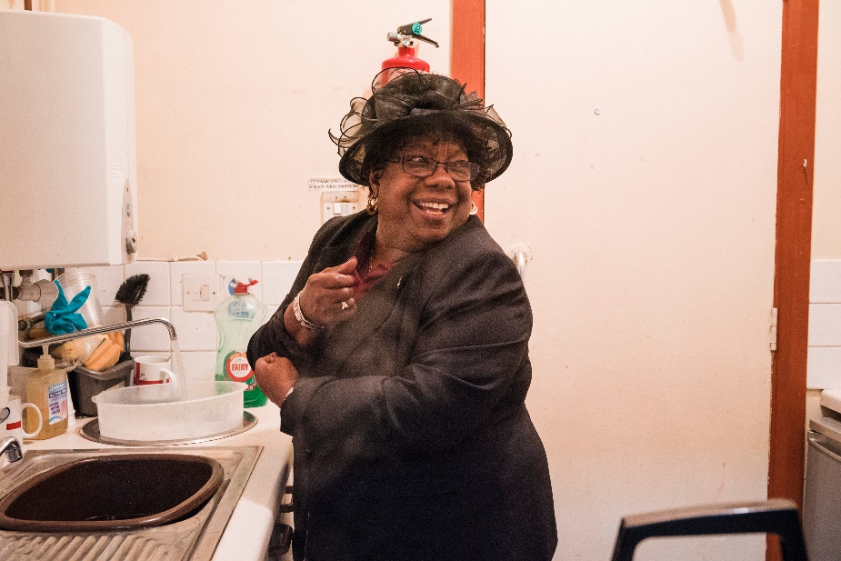
Publicity:
What we do – this year, next year
Websites, social media
Local media
For all the days to come..
Notes:
Finally, although this year we may not have the ceremonies we expected, we are still present in our communities for the people of England at life’s big moments. So are you confident enough to advertise what you do? Be creative, tell stories, remind people that we are everywhere and there for them whatever happens.. For the day. And all the days to com – bereavement, family life, good times, bad times

Slide 14
Just ask
A campaign to tell people:
In our communities
In our buildings
Banners, information and more.
Notes:
Explaining what’s available

Slide 15
Resources:
Invitations
Cards
Liturgies
Creative ideas

Slide 16
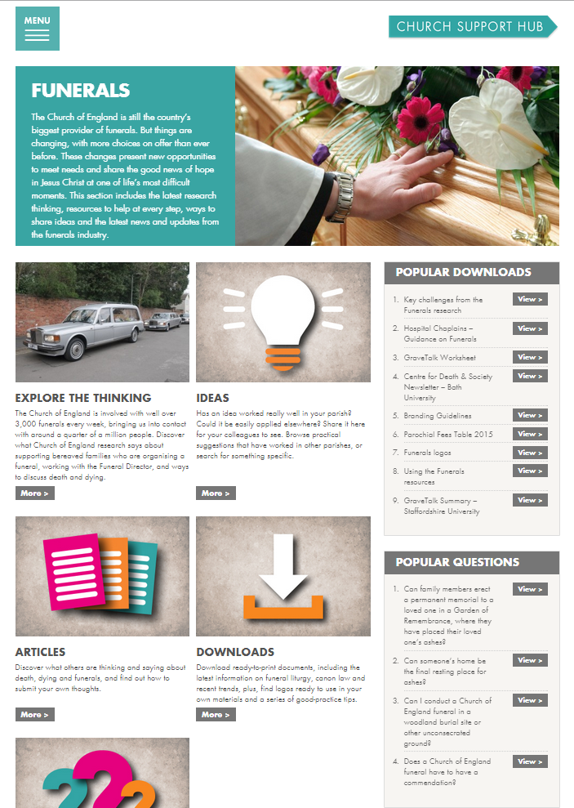
ChurchSupportHub
Information
Insights
Ideas
Downloads
Notes:
This is the main place to get help and information, and to share good practice.

Slide 17
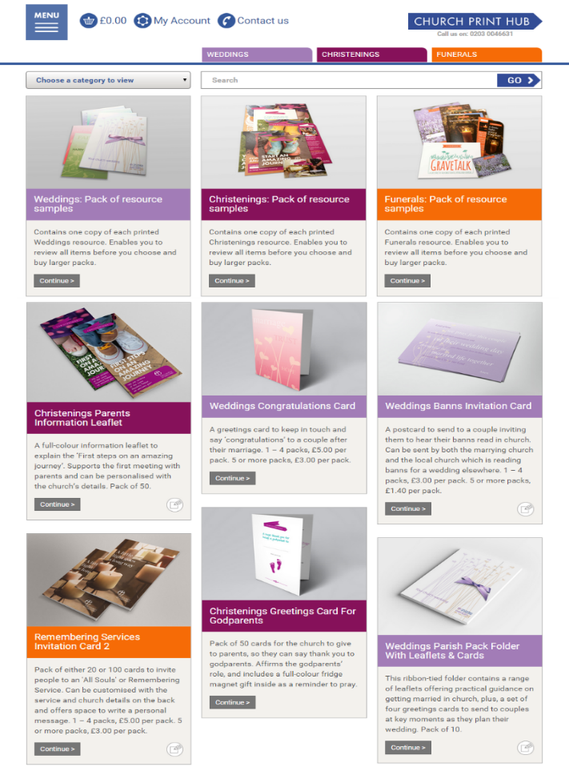
ChurchPrintHub:
An online shop
Choose
Order
Customise
Delivered
Notes:
The print hub is where to buy all the materials as well as other resources. Many are free for now.

Slide 18
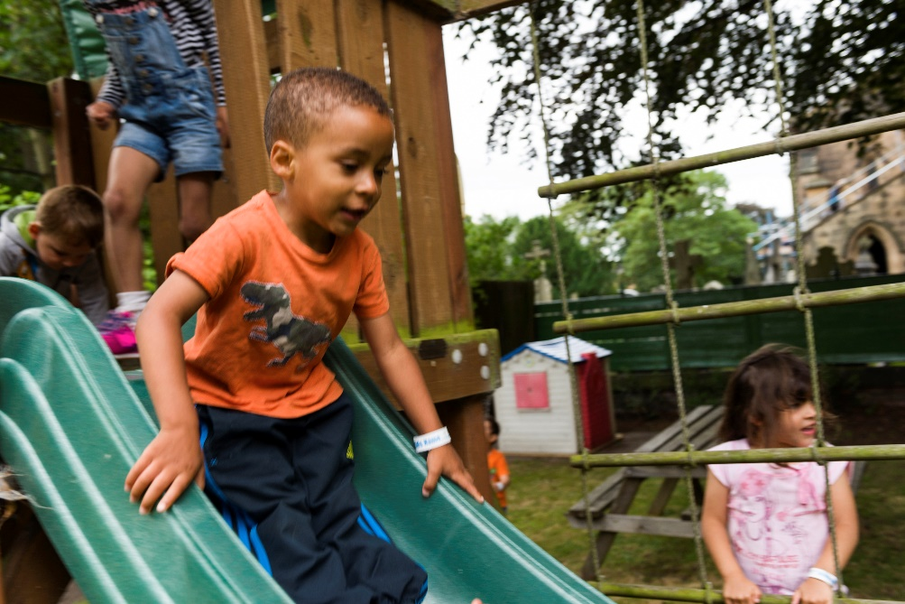
Come back after: a future concern
Impact– reflect on who is affected
Special – build relationship
Significant – focus on the moments
Connect – keep in touch
Resources – be aware
Publicise – have confidence

Slide 19
Questions
Notes:
Tom Pearson will be asking the questions – for me to answer

Slide 20
Thank you and keep in touch
Sandra.Millar@churchofengland.org
Notes:
Just the end slide

