Slide 1
When there is no one left to pay…..
Rev Juliet Stephenson – Director of the good funeral company
Liverpool diocese

Slide 3
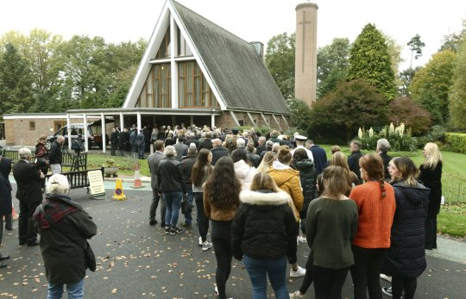

Slide 5
When no one can pay - what do we call it?
Paupers funeral
Public health funeral
Council funeral
Contract funeral
Direct funeral
We call it a funeral !

Slide 6
What are the obligations of the LA? ‘Public health funeral’
They must dispose of the public health risk.
The LA will provide a very basic funeral when someone dies without any friends or family to take care of the arrangements. They can also step in when friends and family don’t have enough money to plan the funeral themselves, or when the person who died was estranged from their family.

Slide 7
What are the obligations of the LA? ‘Public health funeral’
Under the Public Health Act of 1984, councils have a legal obligation to arrange a funeral when no one else is available to do so.
But they can take back the money spent on the funeral from the estate later on, if the estate is large enough to cover the cost. They have three years to do this.
In Liverpool city, they allocate £160.00 of public money to provide an orator to lead a service.

Slide 8
What happens ?
A death occurs
PP look for evidence of will / religious affiliation / preference for burial or cremation
Contract FD collects body / death notice in paper
Body taken to public mortuary
Property Protection (PP) seek to find next of kin
The funeral happens
Contract FD’s and Property Protection Officers choose the details of the funeral
If no next of kin…funds taken from estate…if no funds…???

Slide 10
What happens in Liverpool ?
Our diocesan prayer
Loving Father,
by your grace we long to see
more people knowing Jesus,
and more justice in your world.
Help us to live as your disciples in the power of the Spirit
and to work to your praise and glory.
Amen.
Our challenge
Bring one friend…
Do ten things…
Our rule of life
Called to - pray, read and learn.
Sent to –
tell, serve and give.

Slide 11
What happens in Liverpool ?
A death occurs
Contract FD arranges date etc for funeral
Contract FD collects body / death notice in paper
Body taken to public mortuary
(PP) seek to find next of kin / and any religious affiliation
The funeral happens
A death occurs
GFC will reduce fee to comply with public purse allocation *
GFC will accompany viewings at public mortuary
Contract FD
GFC contact any family or friends
GFC takes a congregation to give thanks in local churches

Slide 12
What's the reality of PHF?
Councils across the UK spent nearly £5.4m on "paupers' funerals" last year.
A Freedom of Information request, by insurance company Royal London, found 275 local authorities spent £5,382,379 on public health funerals in the 12 months up to April 2018.
More than 3,800 of the funerals, for people who have died alone, in poverty or without relatives, were held.
Birmingham's local authority spent the most, £990,437 on for 395 funerals in 2017-18 - about one council-funded funeral for every 22 deaths, which was the third highest rate in the UK.
2017 = 1870 crem church led funerals in Birmingham Diocese

Slide 13
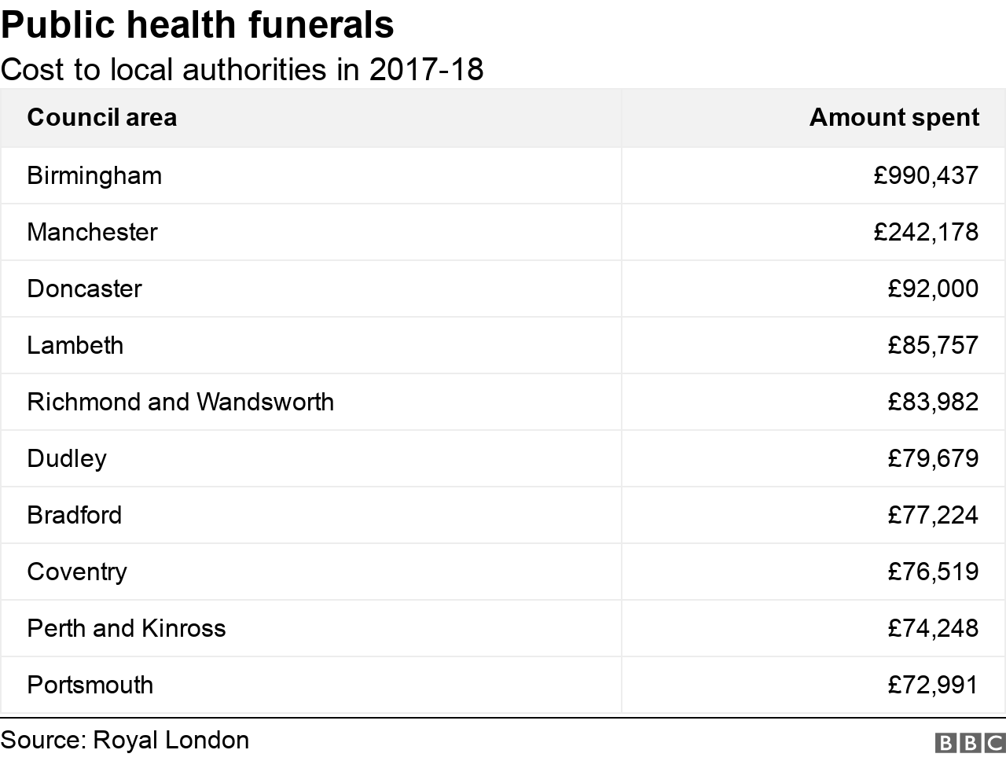
What's the reality of PHF?

Slide 16
What can the church do to help?
Acknowledge the ‘lonely deaths’ in your memorial services
Make a life unique and precious
Find out who holds the LA contract
Work on a deanery level
Pray for them by name
Make contact with the YMCA…do they have a chaplain?
Be creative with liturgy
Bring a congregation
Visit the public mortuary and offer help

Slide 17
What we don’t want to see…

Slide 18
What we don’t want to see…

Slide 19
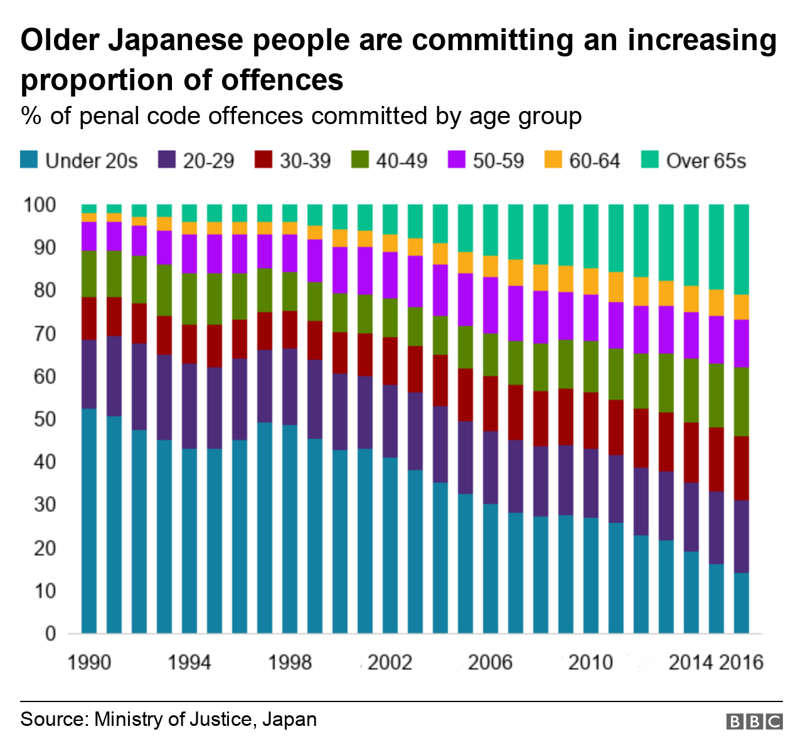
What we don’t want to see…

Slide 20
What we don’t want to see…. Dying alone….Kodokushi

Slide 21
Questions?

